Slide 1
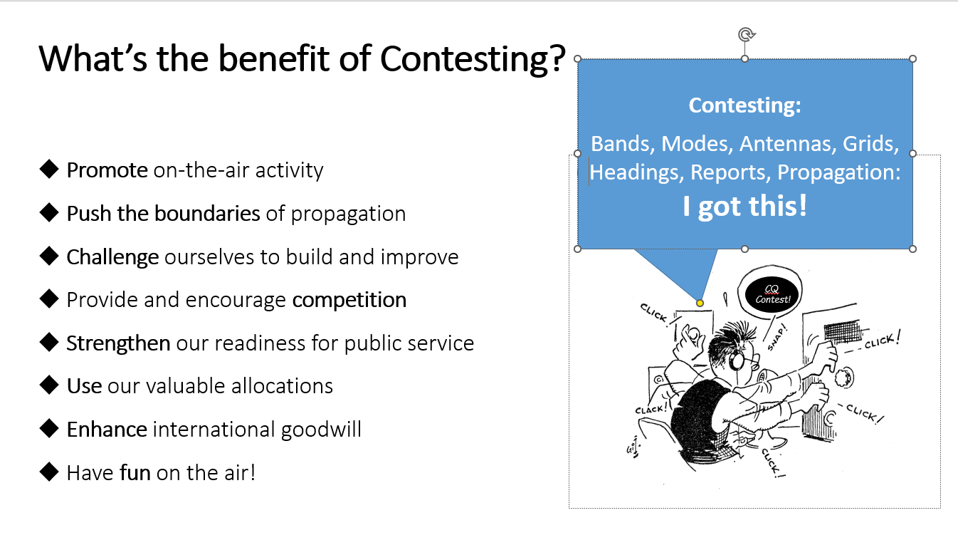
ARRL Contest/Operating Events Update MUD 2023 & 46th Eastern VHF/UHF Conference
Presented by
Bart Jahnke, W9JJ ARRL Radiosport Manager Paul Bourque, N1SFE ARRL Contest Program Manager
Rus Healy, K2UA ARRL Contributing Editor
Image Courtesy dxmaps.com

Slide 2
World’s Largest Radiosport Program
15 Primary Contests * Plaques Awarded + Gavels Awarded January - RTTY Roundup * + January - VHF Contest + February - International DX Contest, CW * + March - International DX Contest, Phone * + June - VHF Contest * + July - IARU HF World Championship 222 MHz and Up Distance Contest + ARRL International Digital Contest + August/September – 10 GHz & Up Contest September - VHF Contest + September/October/November – EME Contest November - Sweepstakes, CW * + November - Sweepstakes, Phone * + December – 160 Meter Contest + December – 10 Meter Contest +
9 other operating events January - Straight Key Night January - Kids Day February - School Club Roundup April - Rookie Roundup – Phone June - Kids Day June - Field Day (not a contest) August - Rookie Roundup – RTTY October - School Club Roundup December - Rookie Roundup–CW
Plaques are available to be sponsored for the June VHF and other contests (see events at left with an asterisk). Cost is $80 each. Contact the ARRL Contest Program at contests@arrl.org if interested.

Slide 3
What’s NEW in ARRL On-Air Operating Events?
2023 ARRL Year Of The Volunteer & Volunteers on The Air (VOTA) – Running January 1 through December 31, ARRL VOTA is a year-long operating event celebrating our thousands of volunteers. Volunteers make routine contacts, together with W1AW/Portable State Activations, then upload them to LoTW. On a nightly basis, LoTW evaluates all 2023 data and tabulates point values for all worldwide call signs uploaded. A Leaderboard (in similar fashion to International Grid Chase) will show point values and QSO totals by call, rank by call, rank by band and/or mode. In addition, we will introduce a Worked All W1AW/Portable States on-line Certificate. https://vota.arrl.org
Analog Category added to ARRL Jan / Jun / Sept VHF Contests – Single Operator (High and Low Power); Single Operator Portable; and Single Operator, 3-Bands entrants may enter in either All Mode or Analog Only mode sub-categories.
Fourth Weekend (a second 2.3 GHz and Up weekend) added to ARRL EME Contest
ARRL Digital Contest (no RTTY) – First weekend in June – 160-6 meters – Grid-square exchange.
RTTY Roundup – Became RTTY only in 2023.
Promoting Contests via Social Media – For HF contest events, such participants are listed in the Unlimited entry category.
Youth Overlay in All Contests – The contest log uploader asks entrants who are 25 or younger to supply their age.
Club Competition, Multiop Station Club Score Distribution – Where Multioperator stations have visiting operators, the score will be apportioned amongst the operator’s home club as specified at log upload.
New for Field Day – No limit on GOTA QSOs (all worth 5 points); Class’s A, B, C allowed up to 500W
Multi-channel streaming and automated operations are prohibited in all ARRL Contests or Awards (eg FT-x Fox and Hound; DXpedition mode; or MSHV are not permitted.)

Slide 4
Who’s behind the curtain?
For each contest, outside authors create the QST and online results. You have seen their names in QST, and you have worked them on the bands. But here’s their names by event (Author/Editor):
January - RTTY Roundup – Jeff Stai WK6I
January - VHF Contest – James Duffy KK6MC / Doug Grant K1DG
February/October – School Club Roundup – Lew Malchick N2RQ
February - International DX Contest, CW = Mark Beckwith N5OT, Phone = Chris Tate N6WM (Kelly Taylor VE4XT)
April/August/December – Rookie Roundup (online scoring by Bruce Horn WA7BNM)
June - ARRL Digital Contest – open
June - VHF Contest – open
July - IARU HF Championship – Bob Raymond, WA1Z (Doug Grant K1DG)
August - 222 MHz and Up Distance Contest – open
August/September - 10 GHz & Up Contest – Rus Healy K2UA
September - VHF Contest – Ralph “Gator” Bowen N5RZ
September/October/November - EME Contest – Skip Paulsen W1PV
November - Sweepstakes – CW = Kelly Taylor VE4XT, Phone = Scott Davis K5TA
December - 160 Meter Contest – Mark Beckwith, N5OT (Doug Grant K1DG)
December - 10 Meter Contest – Andrew Goss AA5JF
When you see the above contributors at conferences, hamfests, DX or HF conventions, please consider thanking them extraordinary work they do behind the scenes to provide these great write-ups in QST and on the ARRL web!

Slide 5
More unsung heros:
You’ve also heard these folks in the contests, and have seen their names in print as well, but honorable mention is deserved to these extraordinary contest program contributors and volunteers:
ARRL Contest Advisory Committee (CAC) – In the recent years, CAC Chairman, Craig Thompson K9CT, (together the CAC Members – and its VHF Working Group) have reviewed several contest topics, resulting in several enhancements to HF and VHF+ events.
Ward Silver NØAX – while he has in recent years begin a graceful retirement from his generous efforts helping the ARRL Contest Program (in addition to writing a bounty of material for QST and other ARRL Publications), what you may not know is that for many years Ward has helped Contest Program Managers orchestrate the complex ebb and flow of contest data, log checking, and results authoring and editing. Many thanks, Ward!
Trey Garlough N5KO and Bruce Horn WA7BNM – Trey is the man behind the scenes for database and contest tables operations, while Bruce has created the many web apps for uploading ARRL (and CQ and other event) logs. Including: Contests, Field Day, HPM/150, 3830-Scores, etc. Bruce also hosts the ARRL event web pages for Frequency Measuring Tests and Rookie Roundup.
We’ll withhold the names, but we deeply appreciate the volunteer efforts of our volunteer log checkers, and volunteer paper-log entry folks. Please thank these folks (when you see them in person, have email exchanges with them, or hear them on the air) for the tireless efforts of these contributors to our contest community!

Slide 6
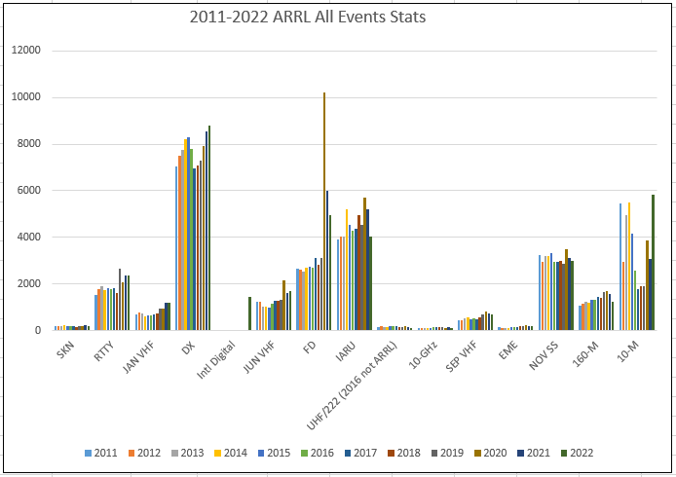
All Events - Contest Activity (Logs) Reported to ARRL 2011-2022 YTD

Slide 7
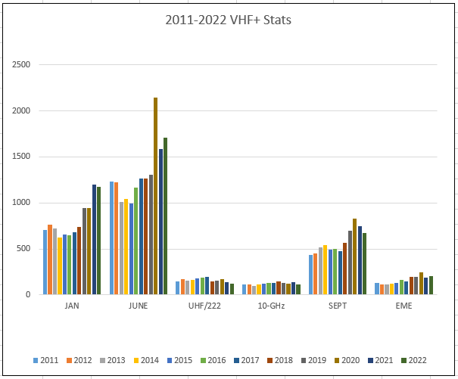
VHF + Contest Activity (Logs) Reported to ARRL 2011-2022

Slide 8
Three Keys to Contest Success
Get on the air!
Have fun!
Send in your event logs!

Slide 9
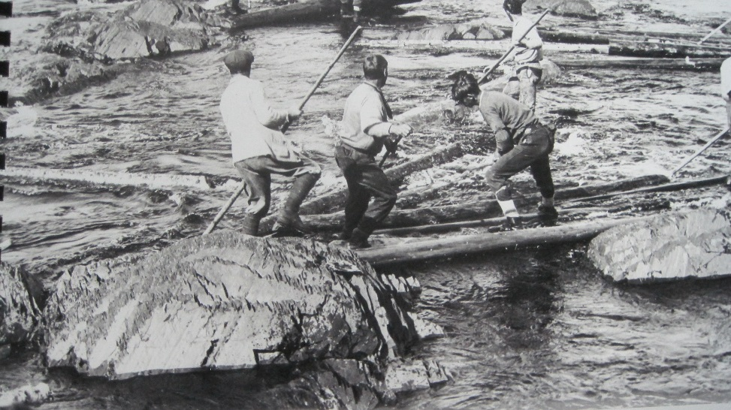
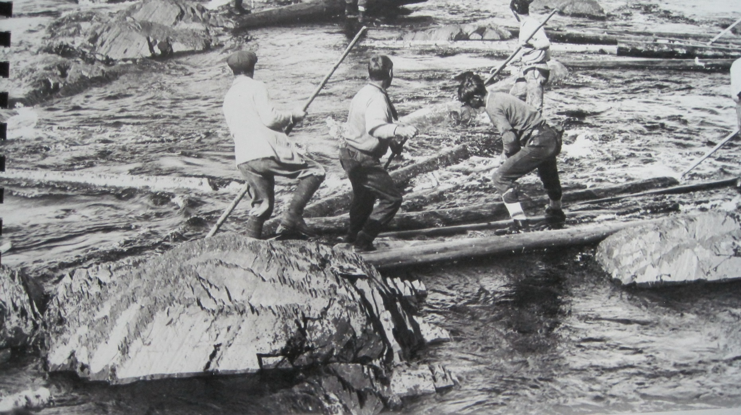
Keep your logs coming after each event…
Go with the flow… Thank you for participating!

