Slide 1

A compendium of Published Modifications to Cushcraft Six Meter Yagis
Some History..…and a Mystery

Slide 2
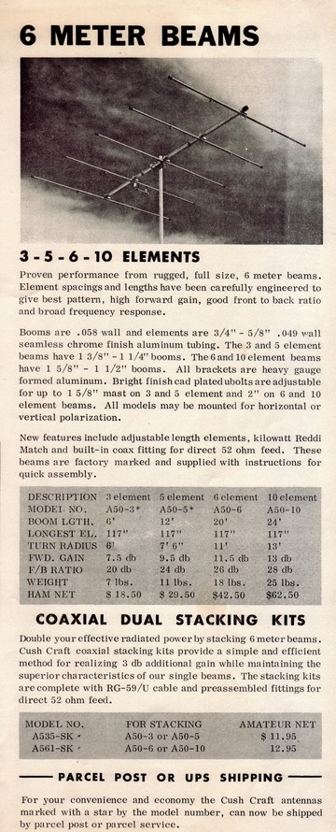
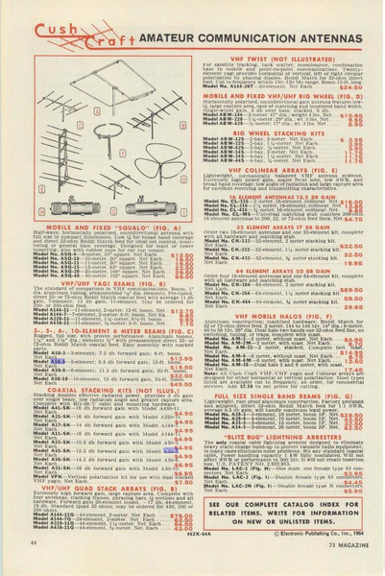
Cushcraft Ads from 1960s
73 Magazine 1964
1964 Prices:
3 Ele - $13.95
5 Ele - $19.50
6 Ele - $31.50
10 Ele - $49.50

Slide 3
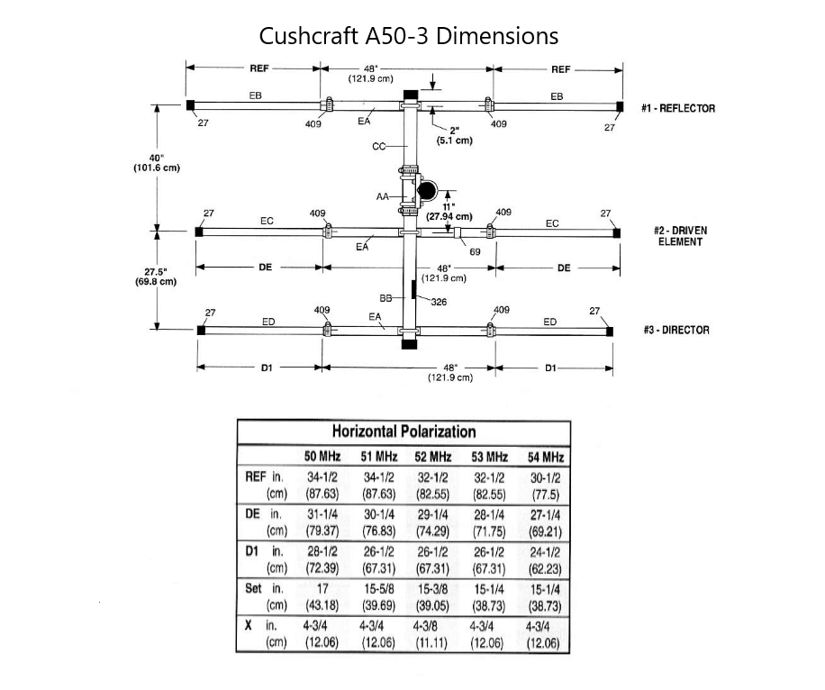
Cushcraft A50-3 72” Boom 5.29 dBd
Wideband design - remember AM, crystal controlled transmitters
Reflector .17λ behind DE; director .116λ in front
Cheap - $13.95 - $18.50 in 1960s
Used standard aluminum tubing
Could rotate with TV rotor
Reasonable gain - 5.29dBd
Still sold by MFJ-Cushcraft and Directive Systems Engineering as DSE3-50

Slide 4
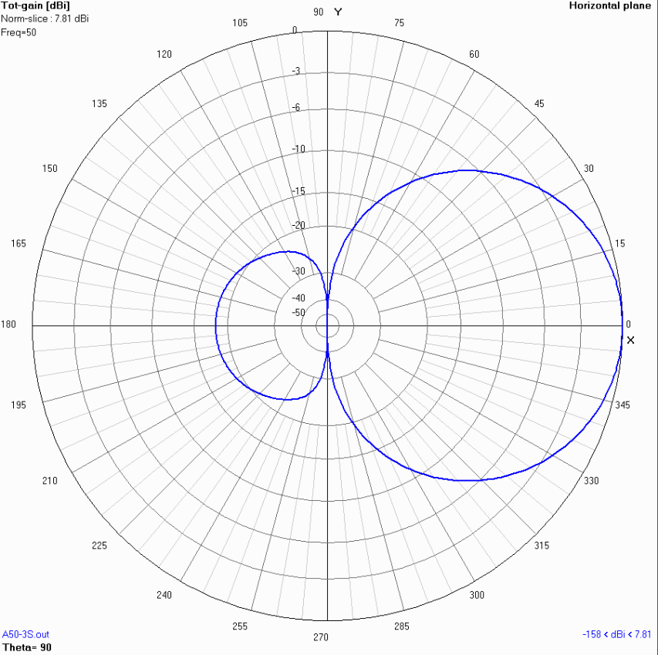
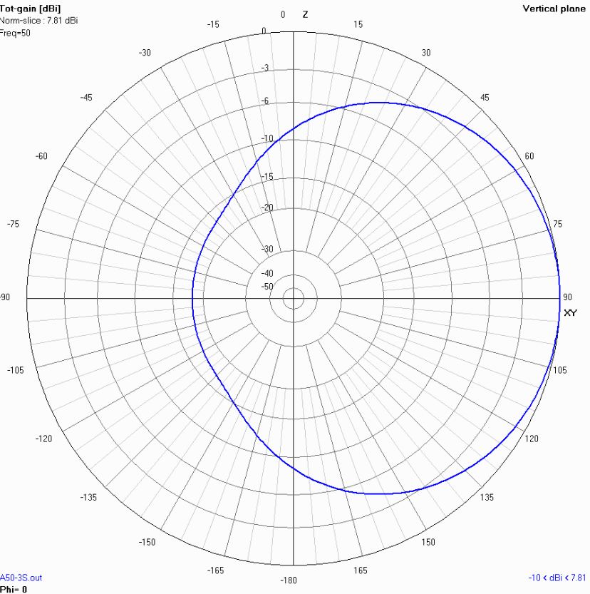
Cushcraft A50-3 E and H Plane Patterns
5.29 dBd Gain 8.8 dB F/R courtesy VE7BQH

Slide 5
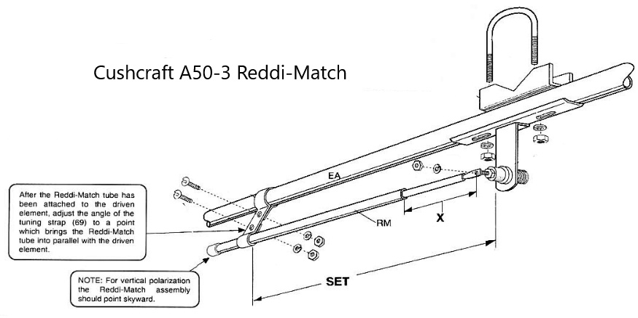
Reddi (Gamma) match – Simplicity
Reddi match -3/16” aluminum tube
Polyethylene insulation RG8
Aluminum rod 1/8” end
Piece of aluminum strap

Slide 6
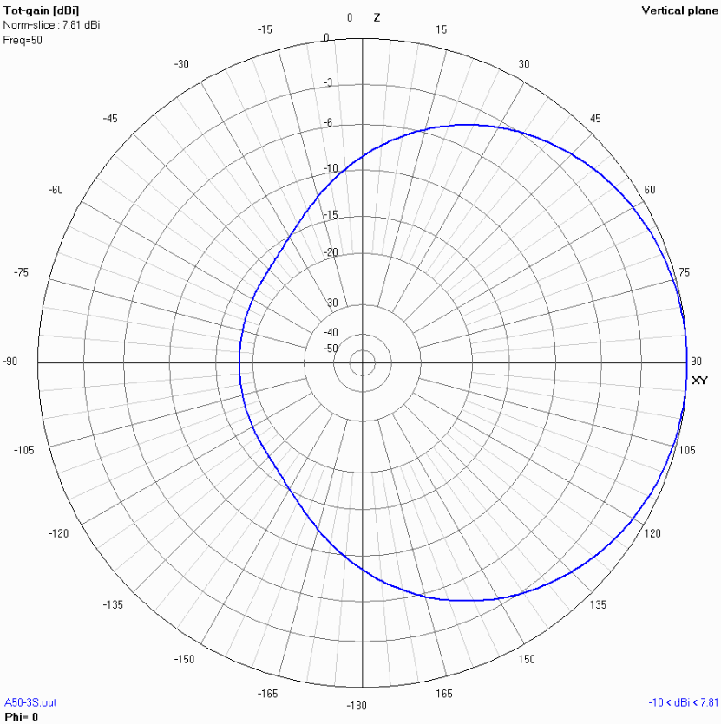
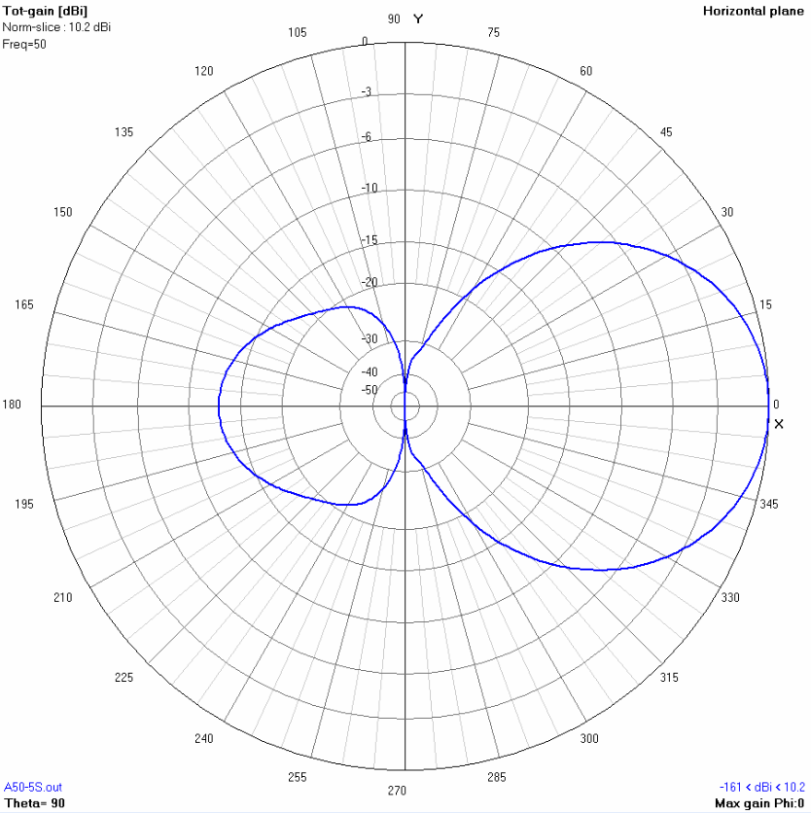
Cushcraft A50-5S E and H plane Patterns
7.59 dBd Gain F/R 12 dBd courtesy VE7BQH

Slide 7
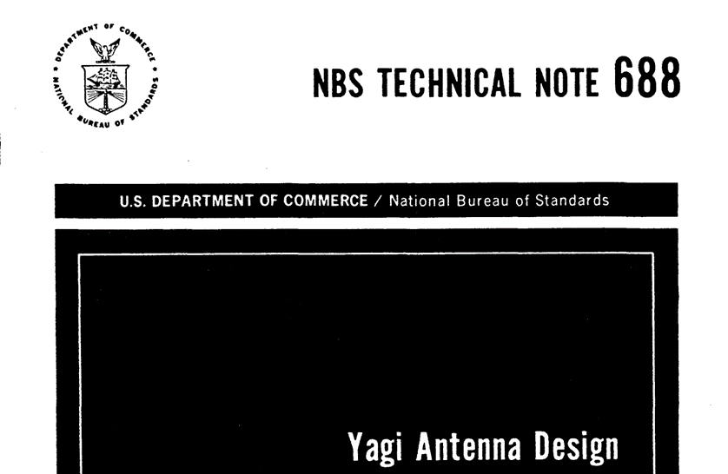
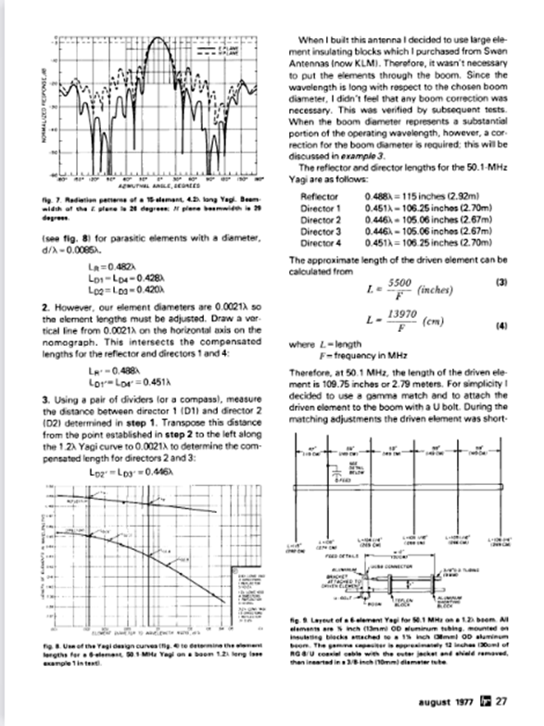
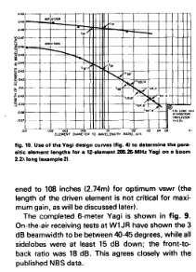
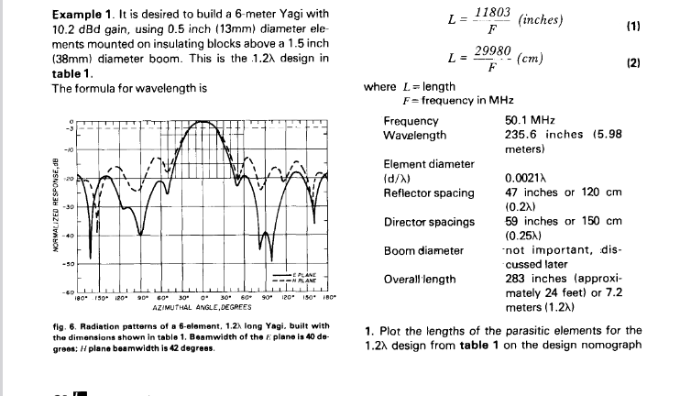
August 1977 ham radio magazine
Cookbook Six Meter Antenna W1JR

Slide 8
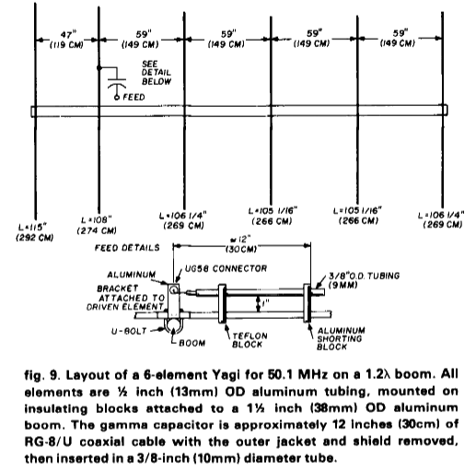
NBS 6 Element 50MHz Yagi at WA3HMK
1987 -1992
Classic NBS Antenna
1.2λ – just under 24’ long
DE .2λ ahead of REF
Directors equally spaced .25λ
Used CC parts including Reddi Match
Tuned easily

Slide 9
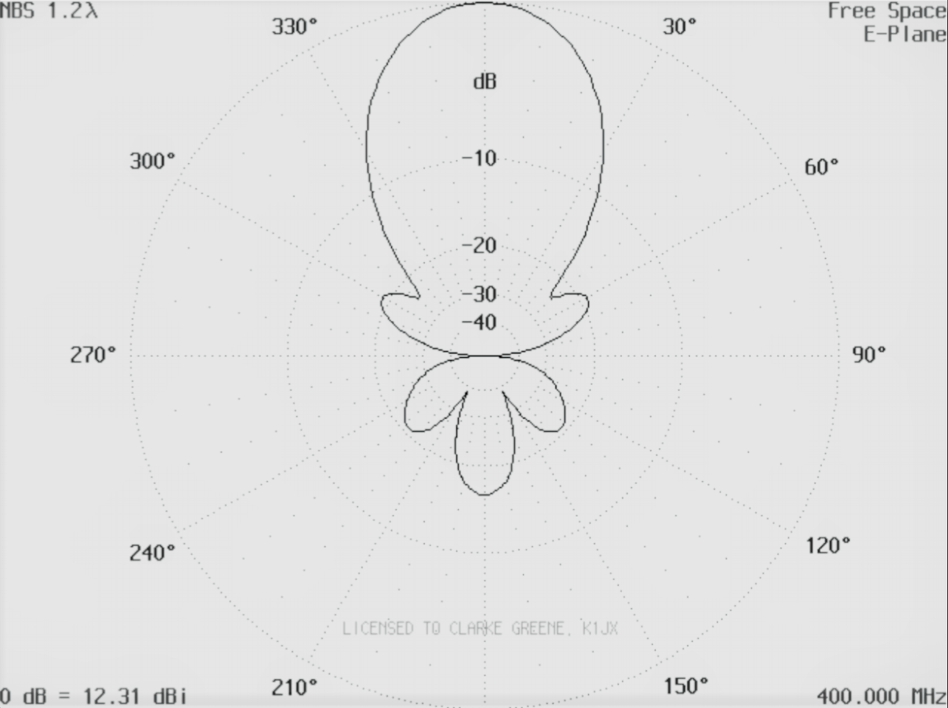
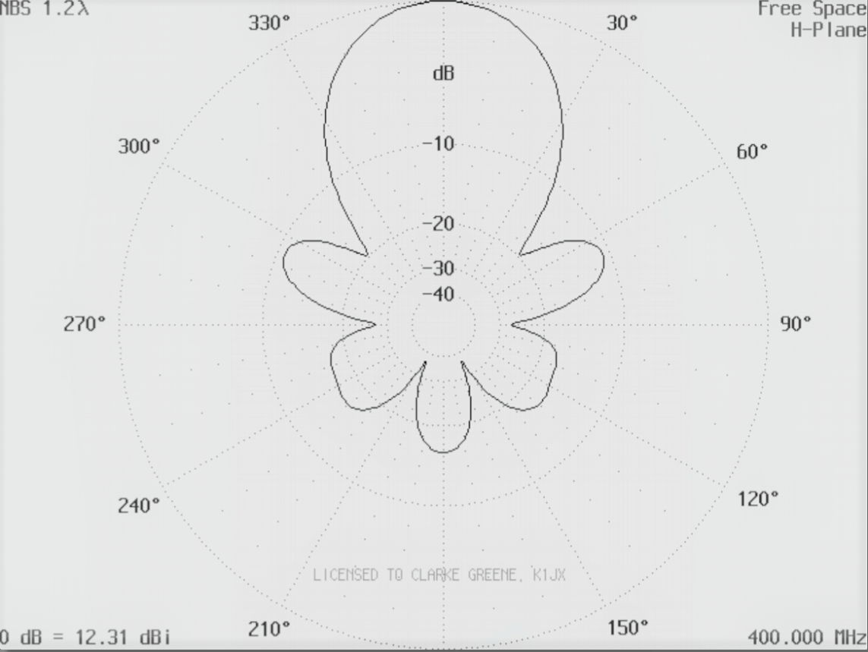
NBS 1.2 W/L Yagi E and H plane Patterns
August 1977 ham radio magazine
Gain 10.2 dBd First Sidelobe and F/R – Poor (-12dB in H Plane)

Slide 10
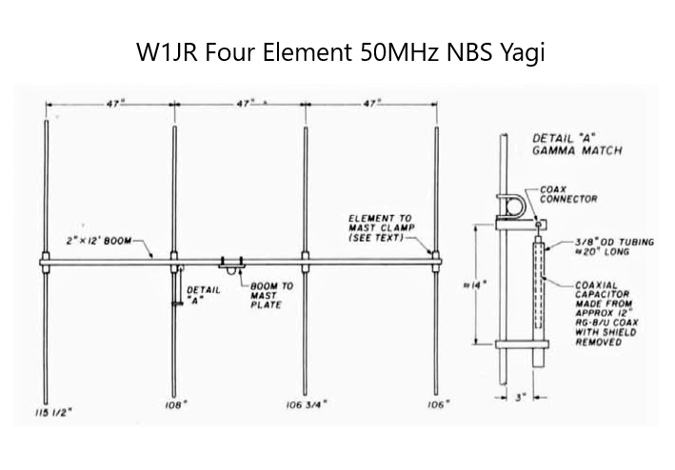
Four element NBS 50MHz Yagi
ham radio magazine June 1977 W1JR
For Portable Use - Gain ≈ 8 dBd F/R ?

Slide 11
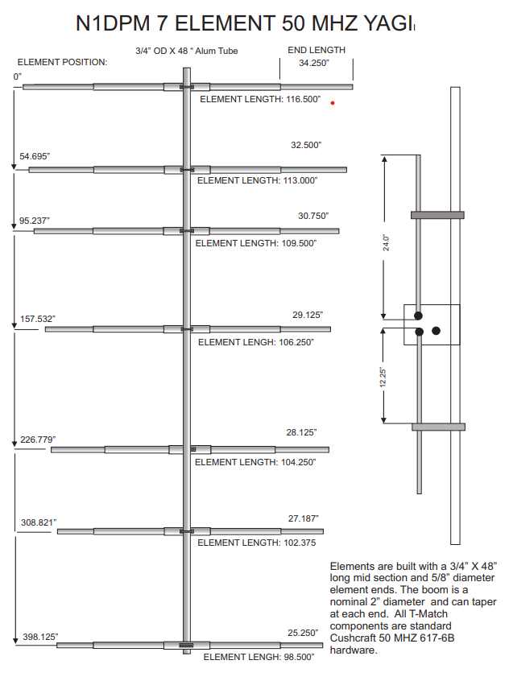
N1DPM Modified CC 6-617B 7 Element Yagi
K6STI YO Yagi Optimizer
Additional Director ¾” Center section and two 5/8” ends
34’ Boom
Gain 10.75dBd F/R 30 dB
Designed for clean H pattern

Slide 12
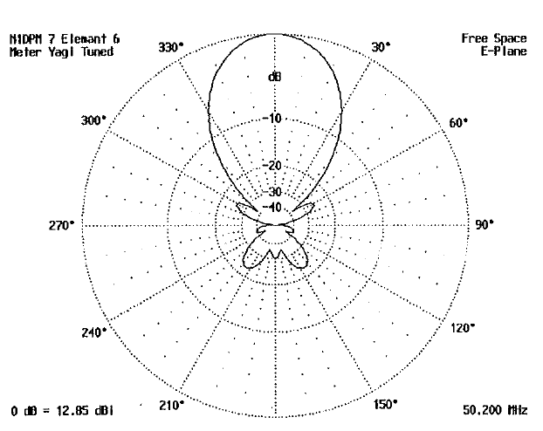
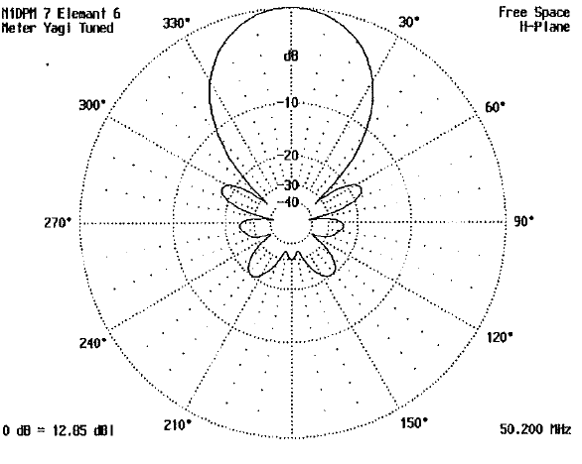
N1DPM Modified CC 6-617B E and H plane Patterns
Gain 10.75dBd F/R 30 dB (at 180 degrees)

Slide 13
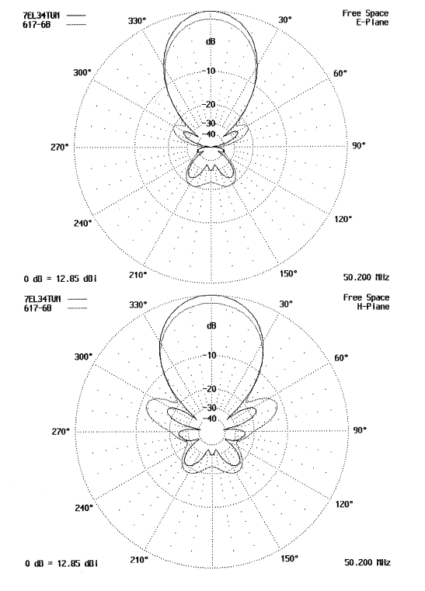
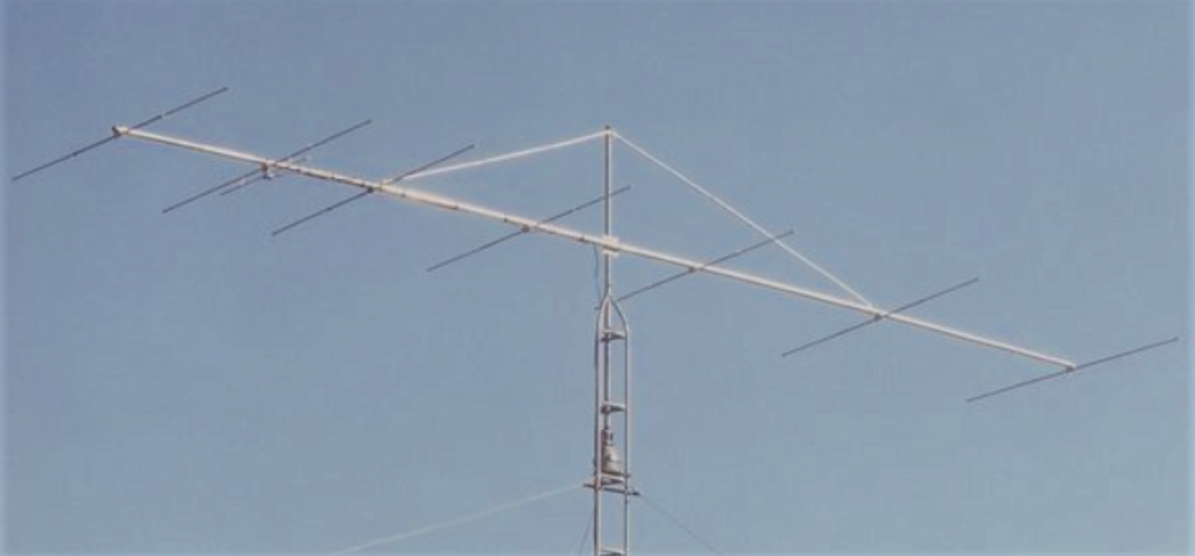
N1DPM Modified 6-167B
Comparison to Original 6-617B
First Sidelobes H plane improved from -12 dB to ≈ -18dB
Forward Gain +1dB
SWR < 1.25:1 – 50.000MHz – 50.350MHz1
Uses All Cushcraft parts

Slide 14
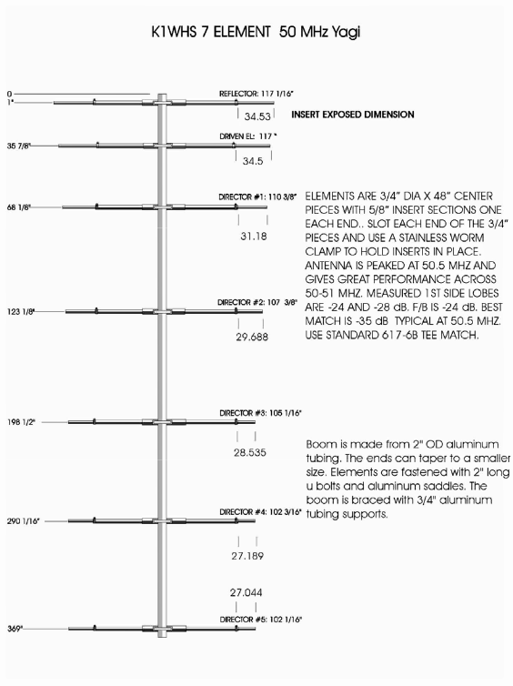
K1WHS Modified CC 6-617B
50 MHz Contest Antenna
2007
Contest Antenna 4-stack vertical array
Wide E plane
Improved bandwidth over the 617-6B
31.75’ boom
10.99 dBd gain F/R > 20 dB
First Sidelobe H plane > -17dB
Some notes on a 50 MHz Contest Array" Dave Olean K1WHS, Mid Atlantic VHF Conference, Philadelphia, PA. October, 1989
https://directivesystems.com/wp-content/uploads/sites/2/2014/04/50-MHZNEWS.pdf

Slide 15
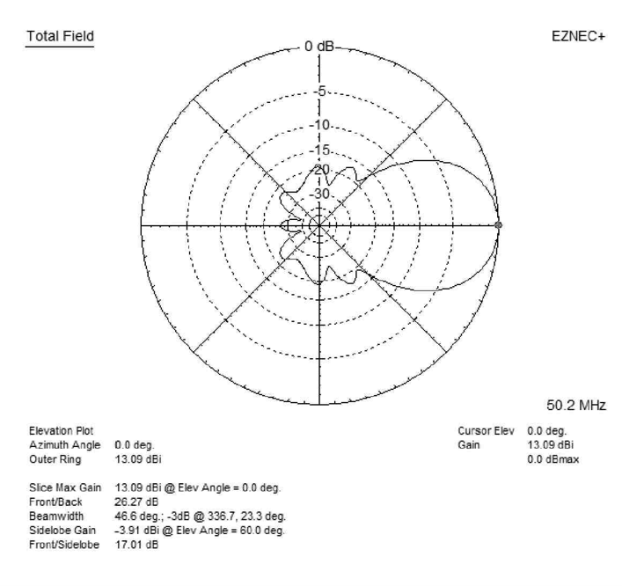
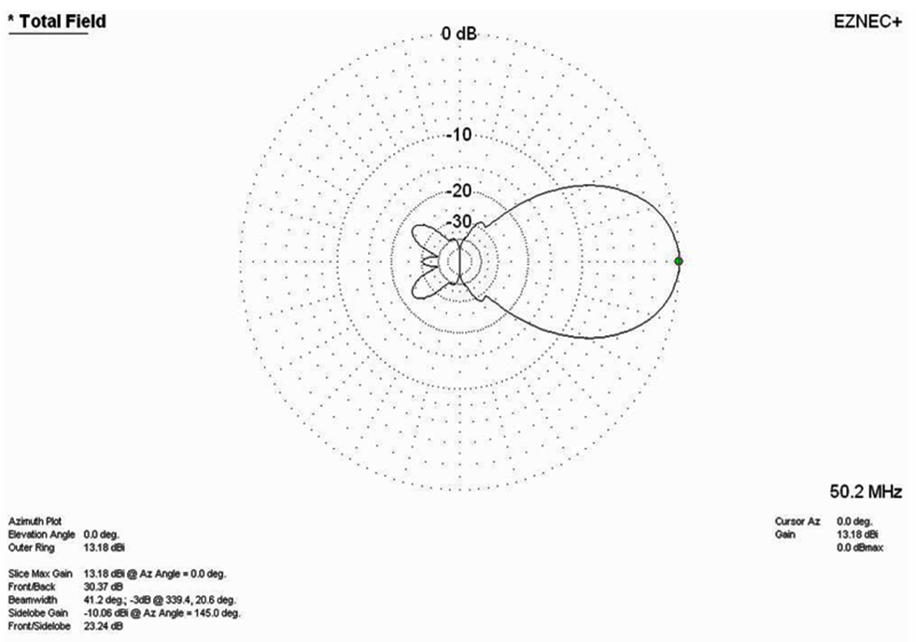
K1WHS Modified CC 6-617B E and H plane Patterns
Gain 10.99dBd F/R 30 dB (at 180 degrees)

Slide 16
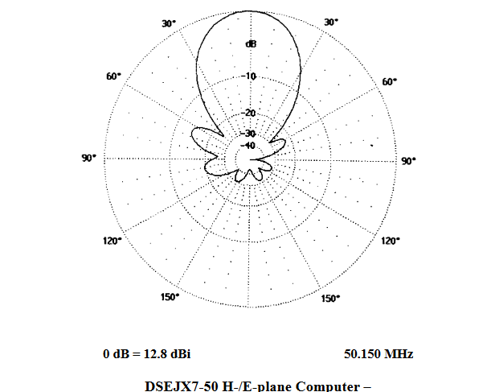
K1JX Modified CC 6-617B
Contest Antenna
Additional Director 28 ‘ 10” boom
K6STI AO Antenna Optimizer
Gain 10.6 dbd F/R 30 dB at 180 degrees
First Sidelobe H plane > -14 dB
Sold by Directive Systems as DSEJX7-50
https://directivesystems.com/50-mhz/

Slide 17
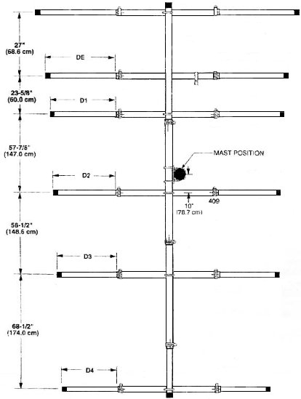
Cushcraft A50-6S – circa 1991
Redesign of A50-6 by W1JR
K6STI YOC program
Elements spacing tapers - no longer equally spaced
Boom 239” - A50-6 boom 21 ½’
Stainless steel hardware
Larger element to boom clamps than A50-5 or A50-5
Retained Reddi (gamma) match
Wideband design - design constraint

Slide 18
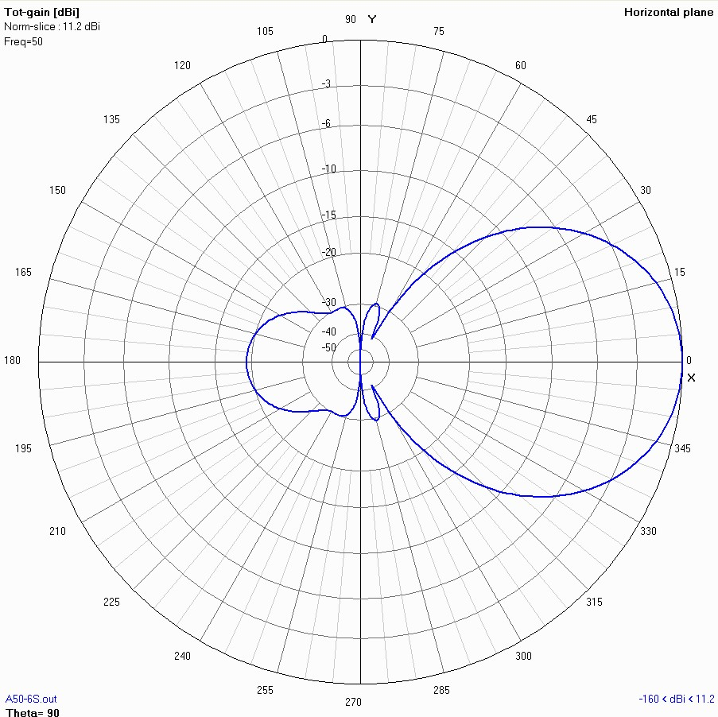
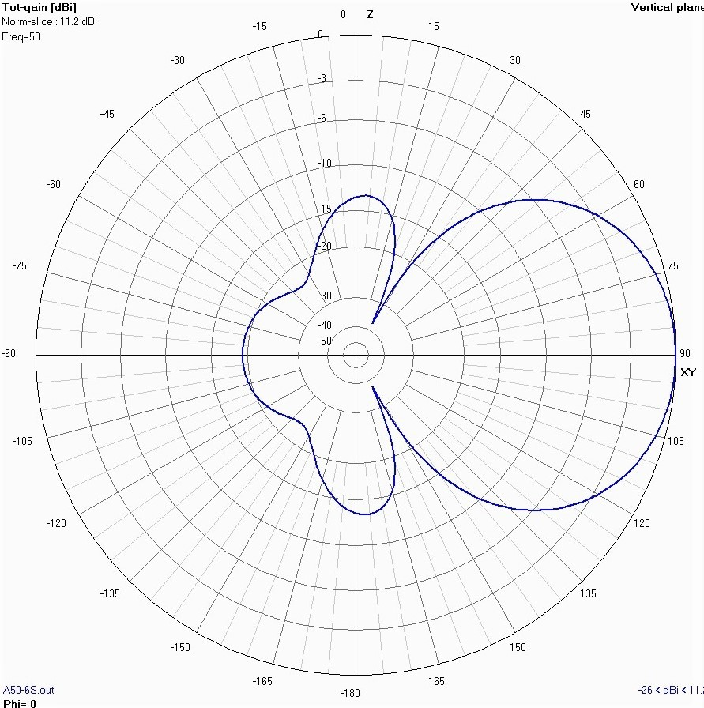
Cushcraft A50-6S E and H plane Patterns
Gain 8.9 dBd F/R 13.5 dB (H plane) courtesy VE7BQH

Slide 19
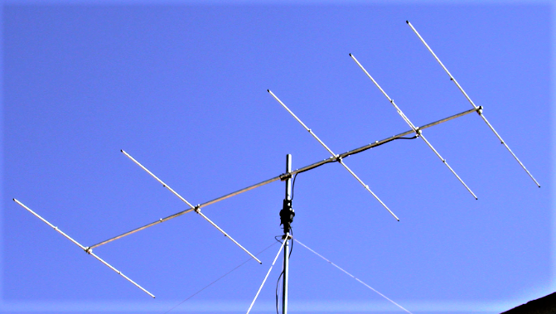
W5WVO Modified
CC A50-5S
First published 2003
One of easiest modifications
https://www.bigskyspaces.com/w7gj/A50-5S_w5wvo.pdf
Boom lengthened from 12’ to 17.5’
Requires only one or two new pieces of aluminum tubing for boom

Slide 20
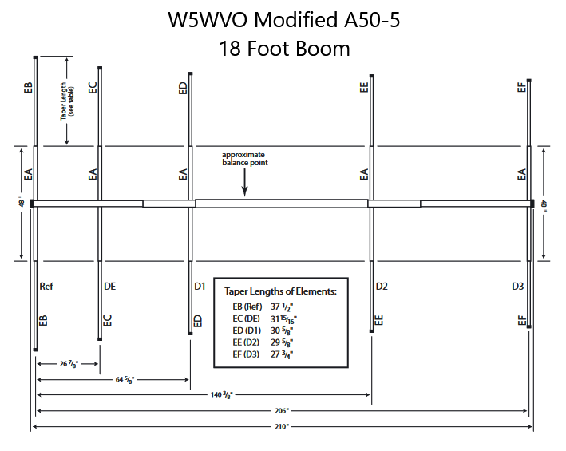
W5WVO Modified
CC A50-5S
K6STI YO Yagi Optimizer
Gain increased from 7.59 dBd to 9.14 dBd
F/R 12.4 dBd (H plane)
May require new 5/8 tubing for reflector if old A50-5 used
In use at HH2JR – robust design
Similar to K1WHS modification of A50-5 for W1TR

Slide 21
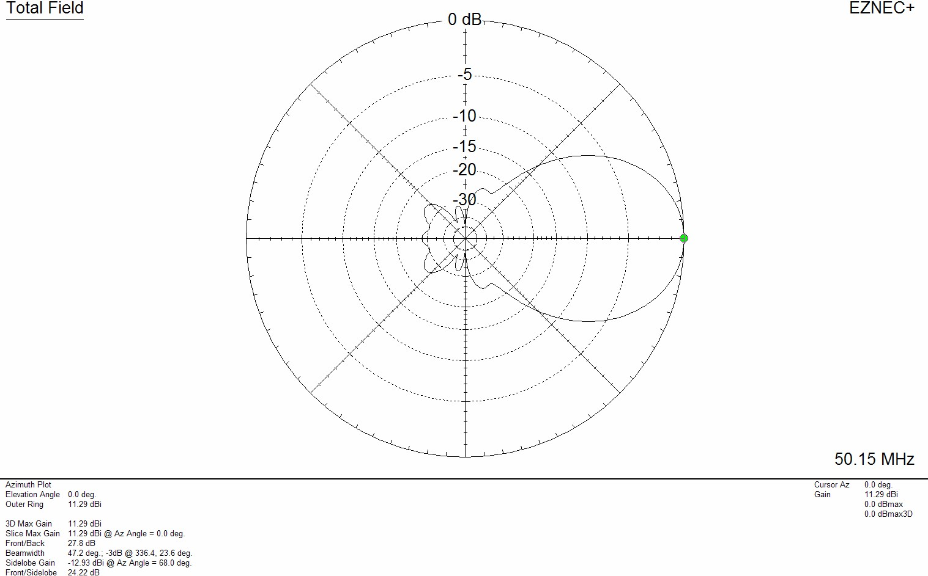
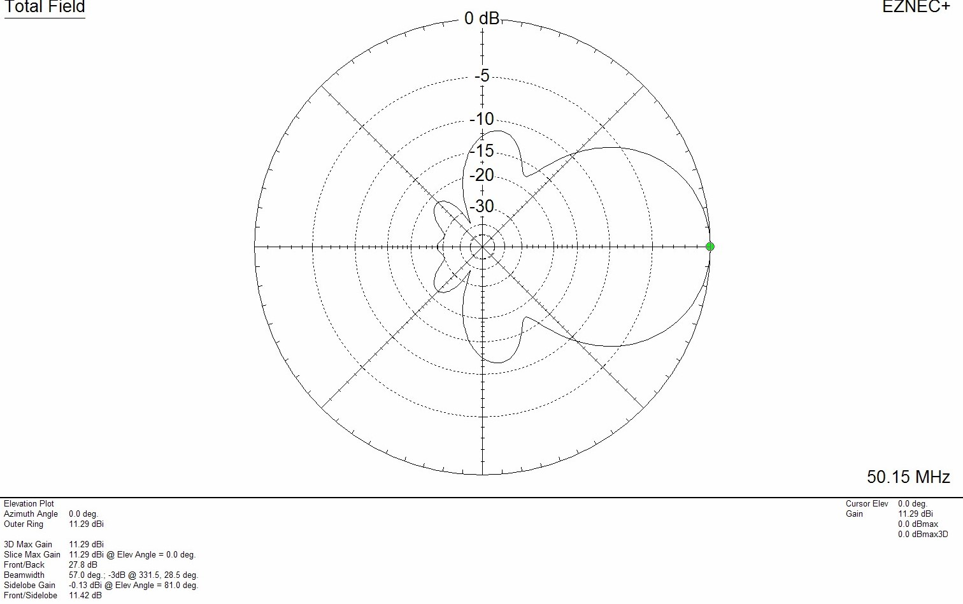
W5WVO Modified A50-5S
E and H Plane patterns courtesy VE7BQH
9.14 BD Gain 12.4dB F/R (H Plane)

Slide 22
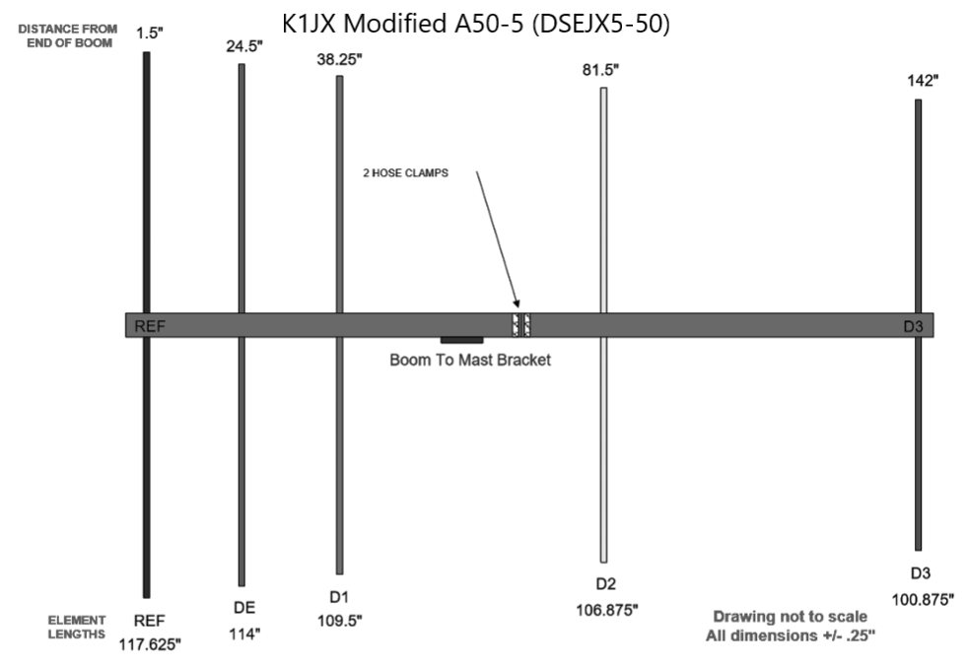
K1JX Modified CC A50-5
Contest Antenna
Wide E plane - 3db points > 60 degrees
12’ Boom retained
No additional parts required
K6STI AO Antenna Optimizer
Gain increased ½ dB
Gain 7.84 dBd F/R 17 dB (H plane)
Gain closely matches VE7BQH comparison chart
Sold by Directive Systems & Engineering as DSEJX5-50

Slide 23
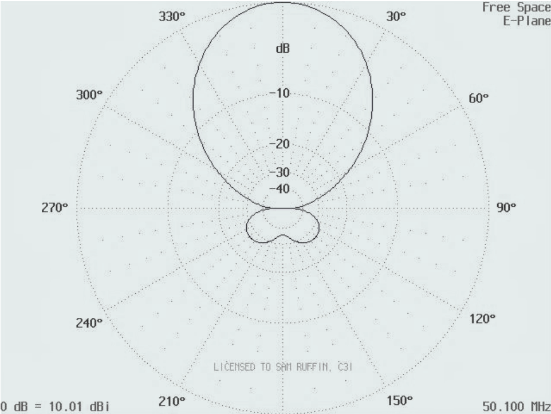
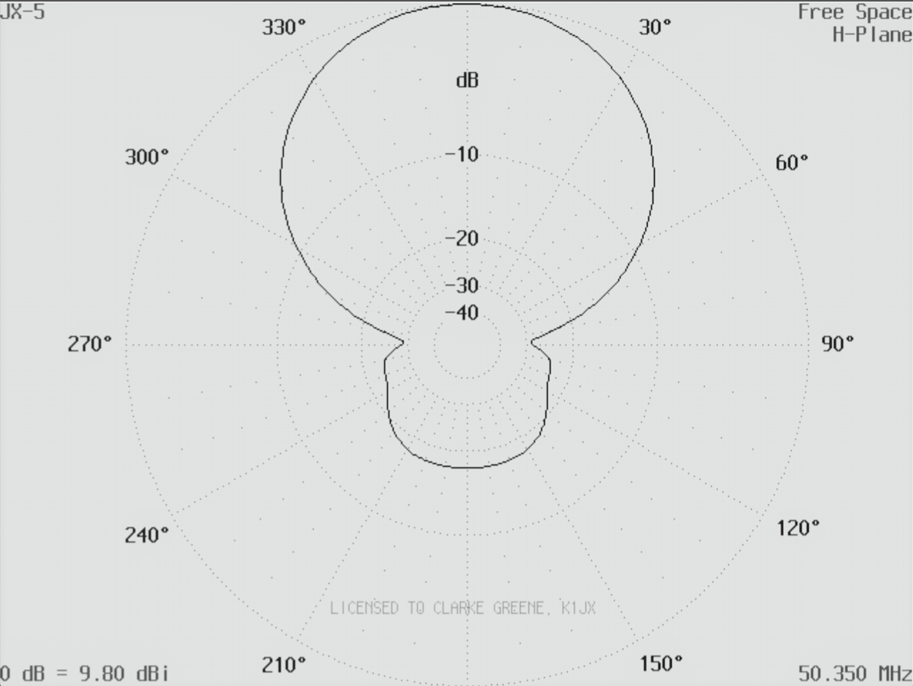
K1JX Modified A50-5S
E and H plane Patterns
Gain 7.84 dBd F/R 17dB (H plane)

Slide 24
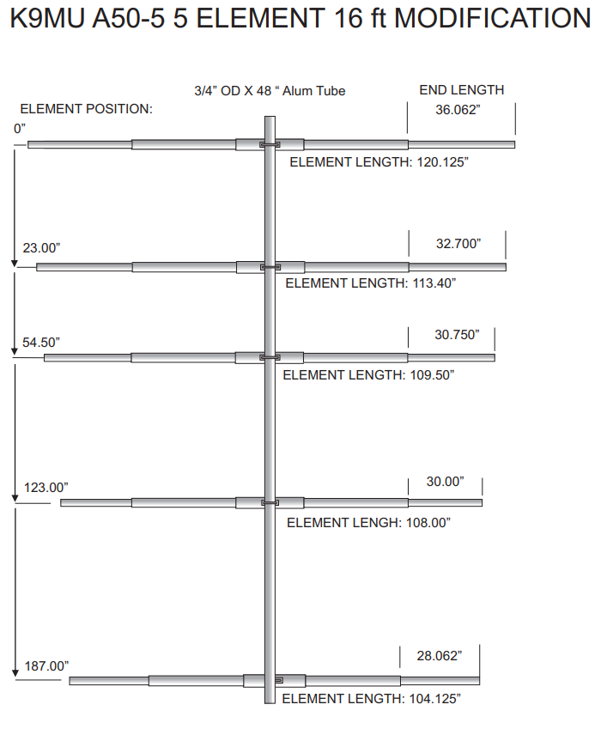
K9MU Modified CC A50-5S
Boom length 16 ½’
K6STI YO Yagi Optimizer
One 4’ boom section replaced with 8’ piece
Gain increased from 7.59 dBd to 8.8 dBd
https://www.k9mu.com/a50-5.html
Also has four element 15 ½’ four element for stacked array

Slide 25
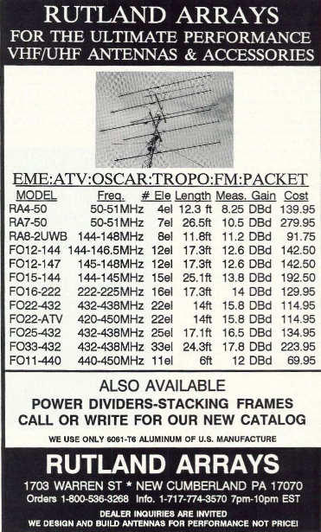
The Mystery – Rutland Arrays RA4-50
Designed in 1980s by Tom Rutland K3IPW (with input from Steve Powlishen K1FO?)
Sold by Bill Olson K1DY at Down East Microwave and Dave Olean K1WHS at Directive Systems
146” Boom - four elements
Gain listed as 8.25 dBd
Originally used T-match; K1DY changed to gamma match
Listed on VE7BQH 50 MHz antenna comparison chart as having T-match

Slide 26
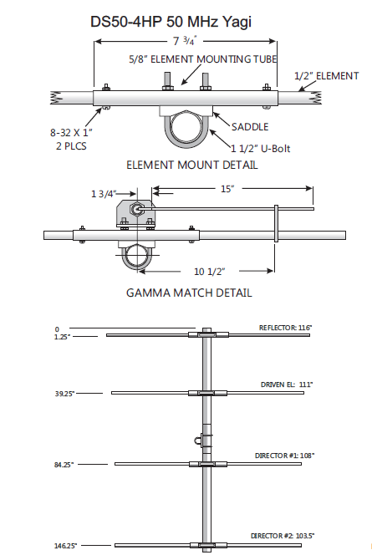
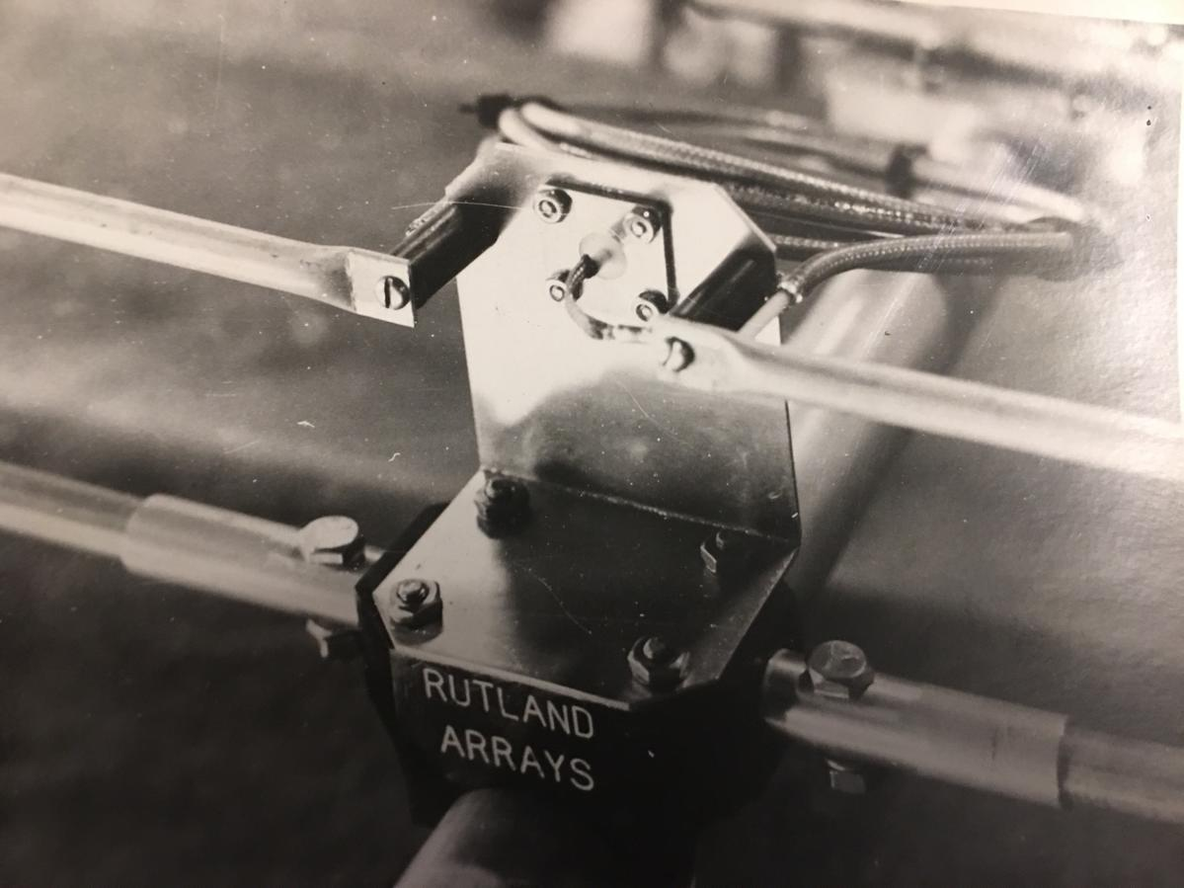
The RA4-50 Mystery, Continued
T-match on Rutland Arrays 50 MHz antenna

Slide 27
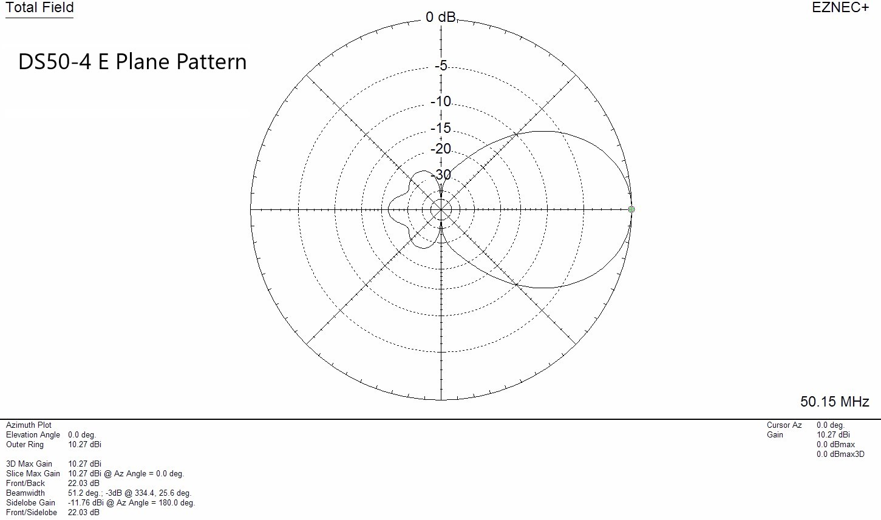
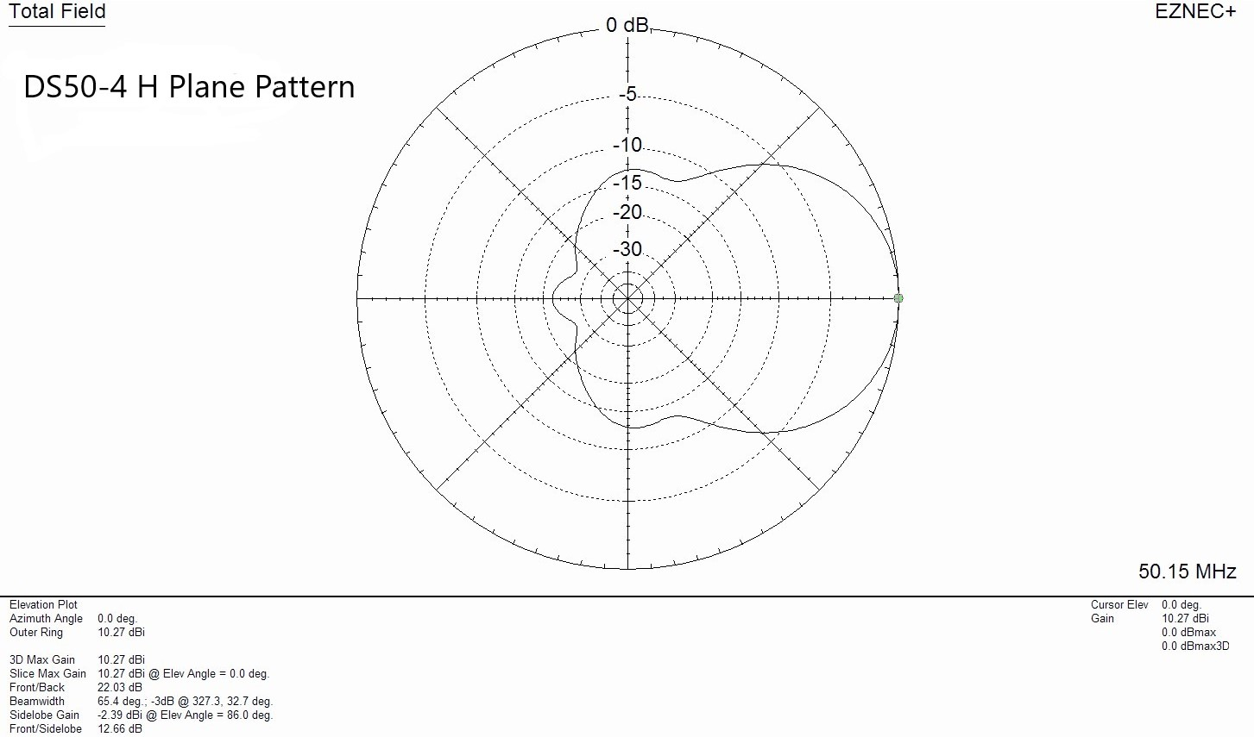
Rutland Arrays RA4-50
E and H plane Patterns
Gain 8.13dBd F/R 12.9 dB (H plane) courtesy VE7BQH

Slide 28
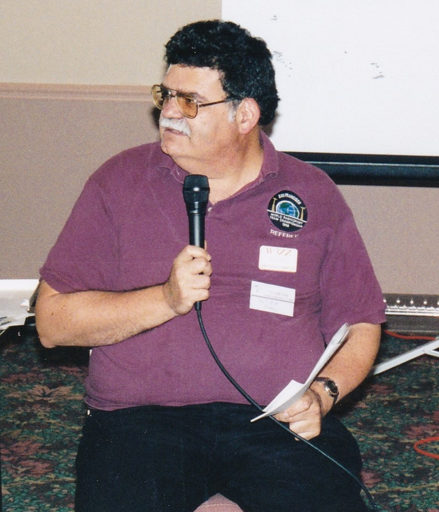
W3ZZ(sk) aka Captain Queeg
"It'll never work!“
"They'll cut our livers out!“
"They're all a bunch of toads“
"The DX will never know the difference“
"You have to run more power than everyone else because they're all deaf!"
"That will happen after I run a 4 minute mile!"
"They can stand on their heads and spit wooden nickels“
"Busier than a one legged man in an ass kicking contest"

Slide 29

Thank you to the following contributors:
Bill Olson K1DY
Clarke Greene K1JX
Dave Olean K1WHS
Justin Glasener K9MU
Fred Stefanik N1DPM
Joseph Reisert W1JR
William Van Alstyne W5WVO
Lance Collister W8GJ
Terry Price W8ZN
Lionel Edwards VE7BQH
Chris Patterson W3CMP March 2023

