Slide 1
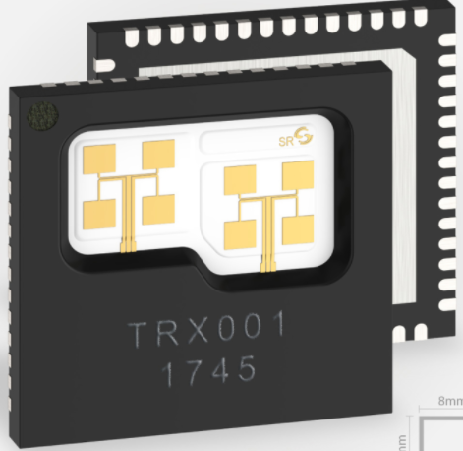
122 GHz Experiments and Construction
Doug Millar K6JEY
Tony Long KC6QHP

Slide 2
It Started in Australia
After years of difficult to get or expensive parts and no one to talk to-
VK3CV Tim Tuck, develops a board based on a Silicon Radar chip for 122GHz that promises simple operation on 122GHz.
Antenna was the problem. They developed a combiner that made a single horn or chaparral feed possible and that made the project possible.
All that is left is to do DC wiring and drill holes.
Meanwhile a group in the Bay Area has been working on a similar project- but that is a different story.
The Silicon Radar chip is good for 0.5mw output and 10db NF.

Slide 3
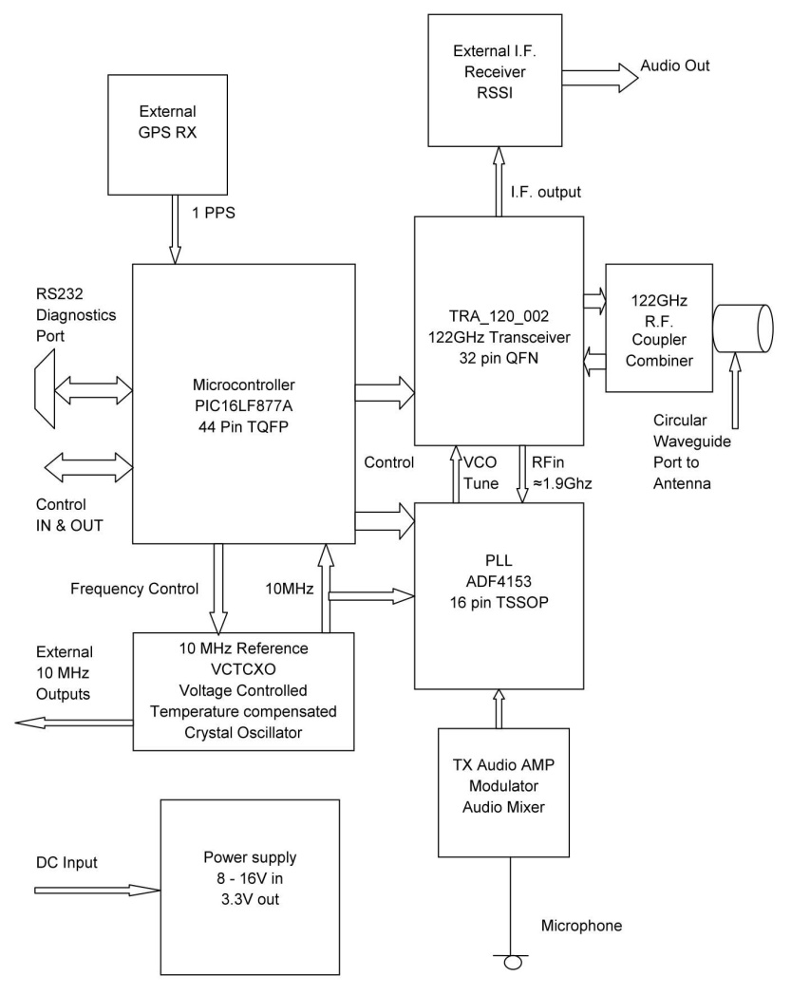
The Board Block Diagram
All you need is-
Jacks for
microphone
DC input
144mhz output
Switches for-
Mode
Off/on
TX/PTT
Indicator lights
GPS is not needed.
(Disable the ptt on the HT)

Slide 4
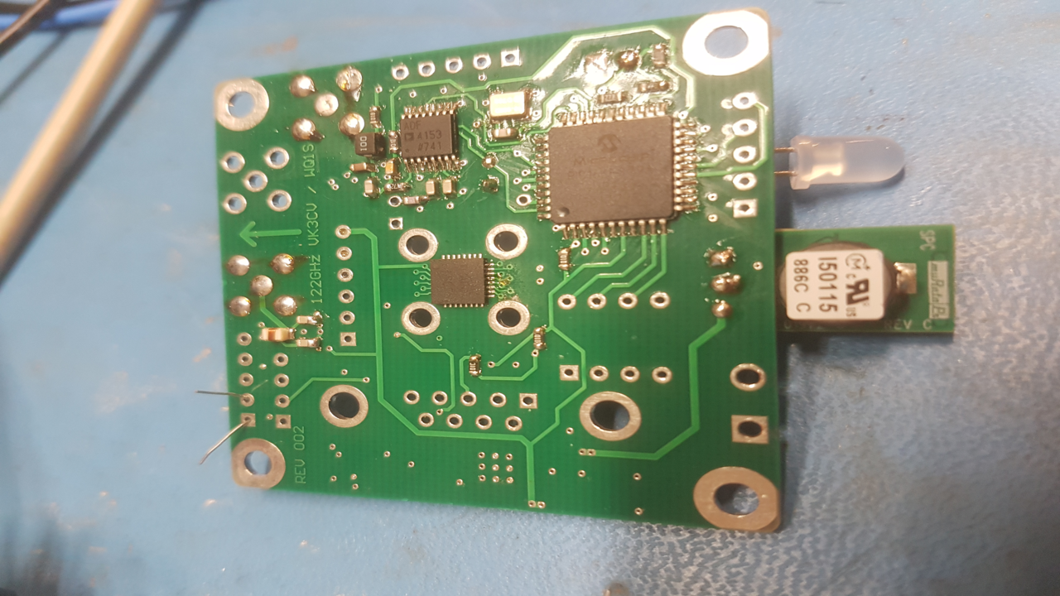
The Board
First Run

Slide 5
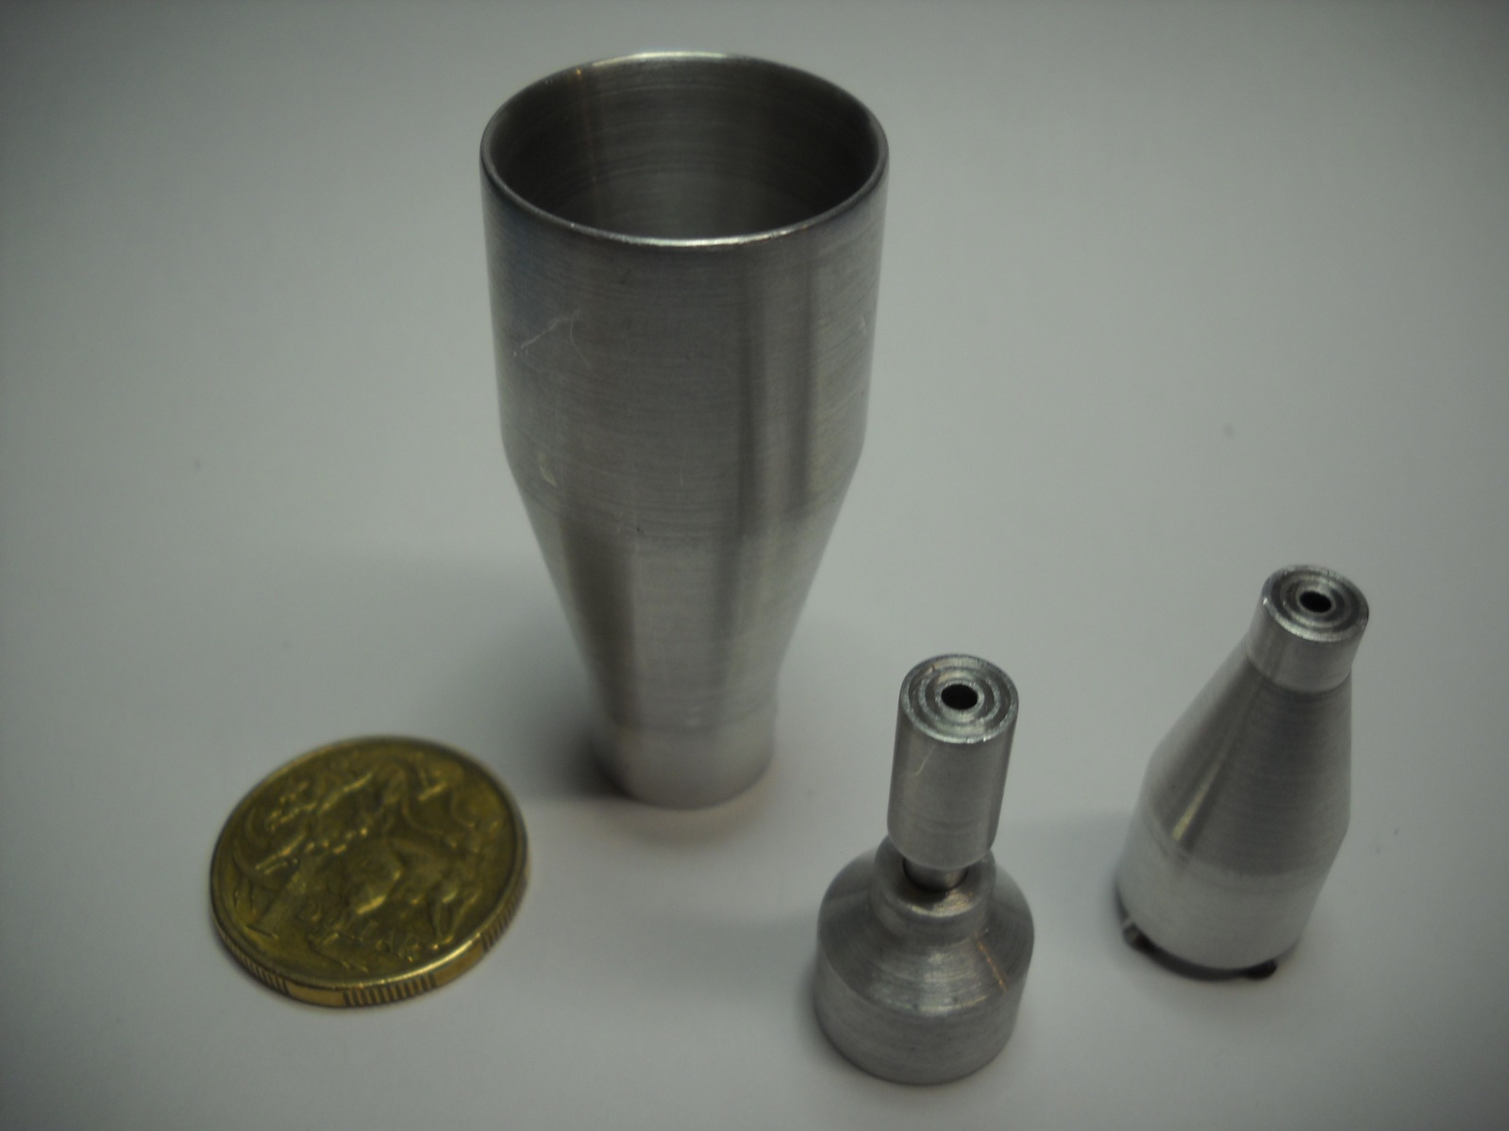
Feeds-
Horn with combiner
Chaparral feed with combiner
WR8 adapter with combiner

Slide 6
Levels of Complexity
Basic Level-
Start simple and build more as you get better.
Full Duplex,
IF radio is an FM receiver on 2 meters (Baofeng works fine)
Horn antenna for 20db gain.
  Easy to use, pointing and tuning are easy
  More than 3 miles is difficult

Slide 7
Intermediate Level-
Horn plus lens antenna, 10db more gain.
Use an OCXO for CW, and multimode 2m receiver. (I use an Alinco
  DJ X11 wideband receiver.)
Pointing needs a riflescope to help. Pointing begins to be challenging.
Stability and frequency accuracy good for CW.
Think 2ft dish on 10GHz.
Start to see variable effects of propagation.

Slide 8
Advanced level-
Dish antenna-
  10db better than lens.
  Pointing becomes more challenging
  More problems with propagation vs distance.

Slide 9
Future Improvements
The Third run of boards will be dual frequency 122/134GHz. Date?
Many people doubled their order for the second run, so boards are available.
The instructions to make the radio are pretty complete
But make sure you can solder well around surface mount components.
A series of building sessions at CGR’s lab might be a good idea.
A good location that is local, is from Oilwell park on Signal Hill down to LGB airport and other spots.
Who would have ever thought the hot tip in ham radio would be 122GHz?

Slide 10
122 GHz is the Hot Homebrew Band
Once you have the board, some switches and plugs, the rest is up to you and your needs and creativity

Slide 11
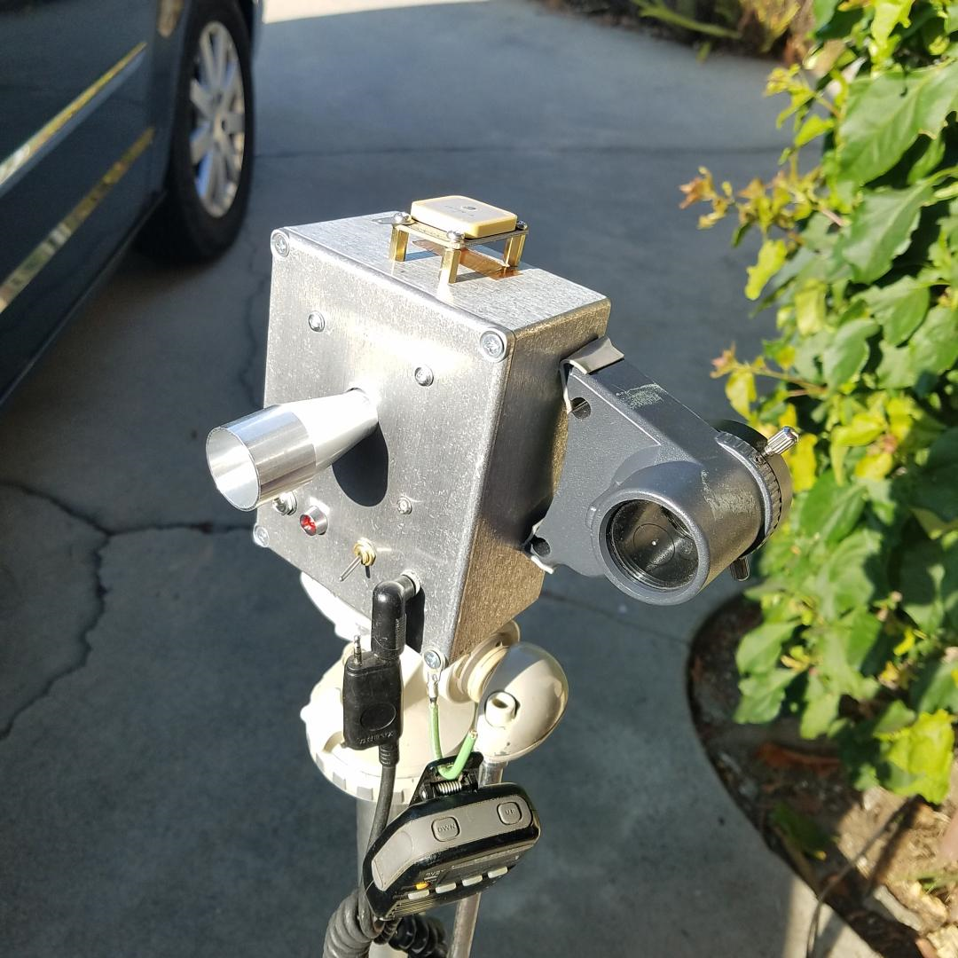
Crude Beginnings
Basically a good idea. But-
What didn’t work-
GPS not necessary
Zero power finder not enough
Switches on the front moved to
Back.
New main board with better
mic circuit. (Huge improvement)
Using a Linhof tripod.

Slide 12
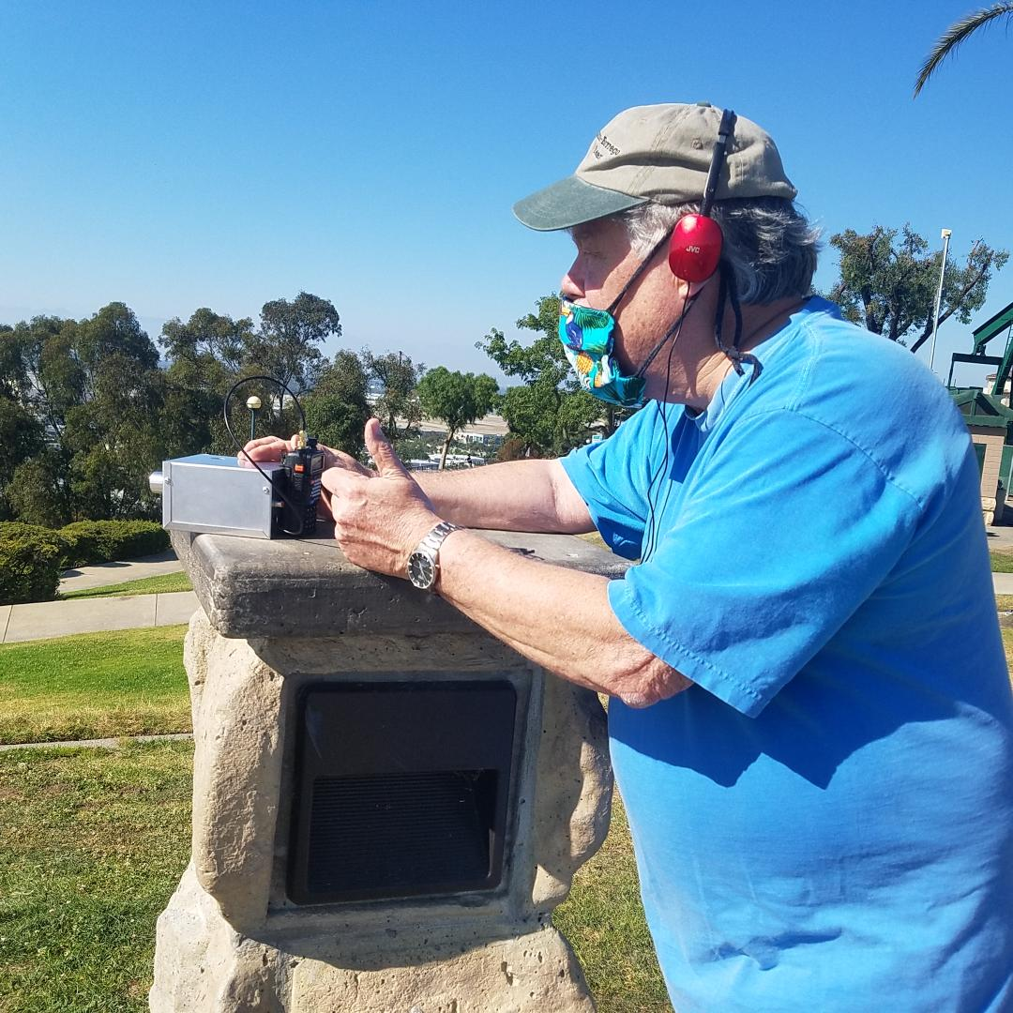
More Rigs
N6NB’s version.
Internal microphone
Headset.
Baofeng HT.
Felt like a Gunn diode
rig.
No tripod
But it worked!
2.5 miles with good
Signals!

Slide 13
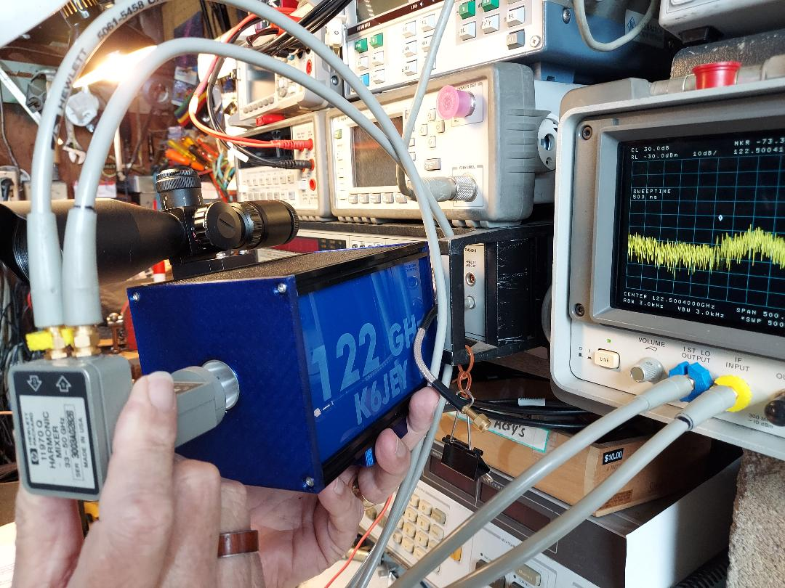
Optimized version
Testing-
With hp11970Q mixer in
front of the horn
Second run board
Custom box
Flush mount horn
Scope well mounted.
Cool looking.

Slide 14
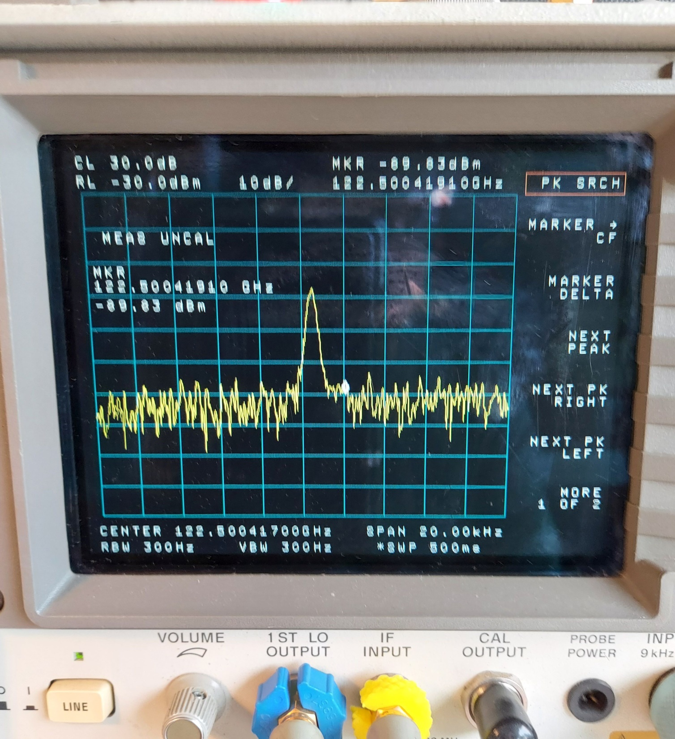
Better Analyzer Picture
HP8563AC tuned to
122,500.417000MHz
GPS locked.
Phase noise is better than the
  Picture.
Using a 50GHz mixer
HP8563A’s are about $1500

Slide 15
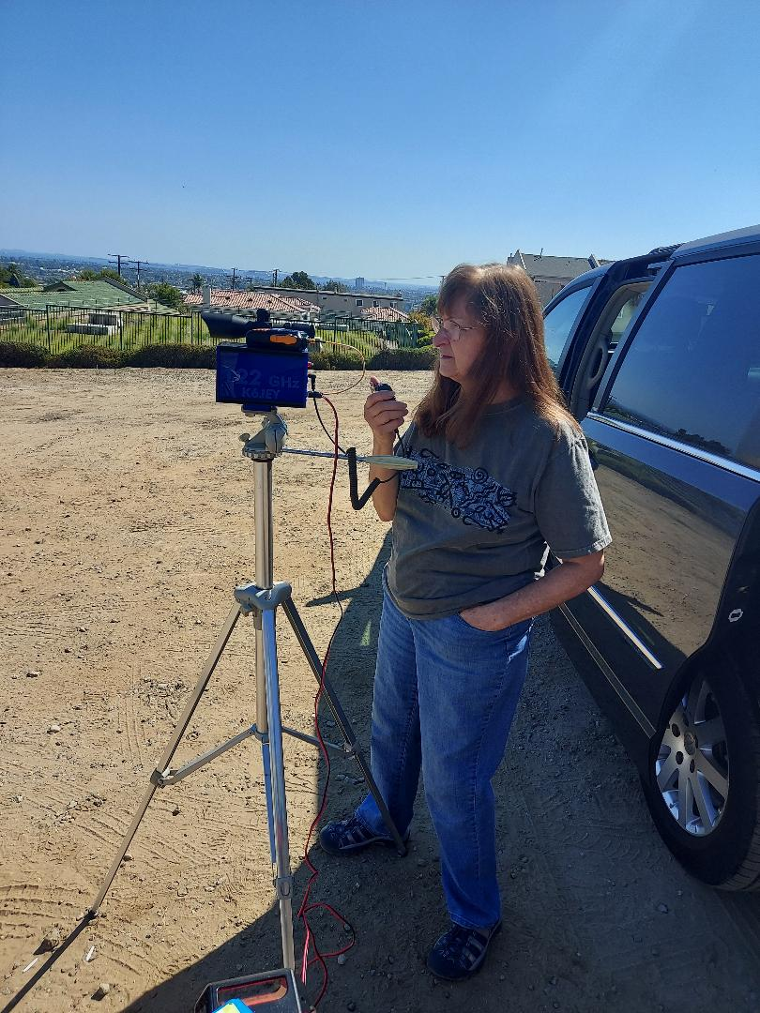
Helen with Tony’s first run- Optimized basic radio
Solid Linhof tripod
Baofeng UV6r HT
Rifle scope
External Mic
Bienno battery on
the ground
Horn just peeks out of the box
Easily does 4 miles.
PTT modified so the HT will
never transmit.

Slide 16
Next-
Intermediate Level Details
- With Tony Long

Slide 17
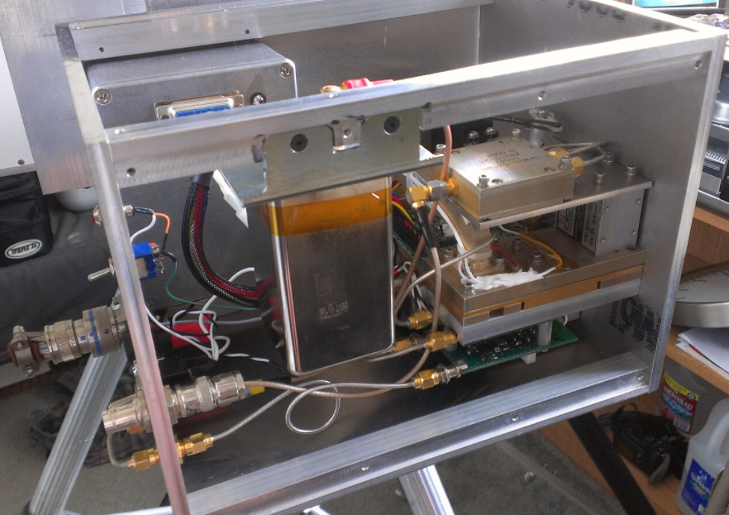
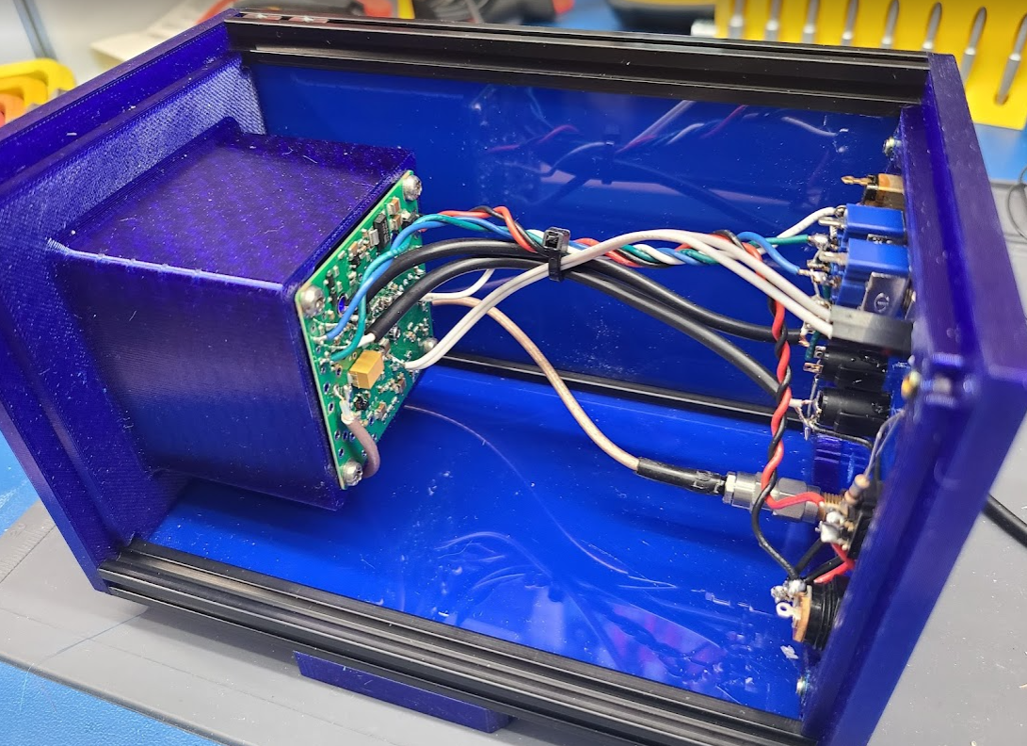
An Improved 122 Ghz Radio Chassis
Things I like in microwave radio chassis:
Modular design
Clean wiring
Flexible mounting options
Durable
Field serviceable
Ten Years ago my radios:
Had lots of machined aluminum
Took months to build
Since then, 3D printing, laser engraving, and better parts have become more readily available.
Now my radios feature:
Aluminum structural extrusions
Lots of custom 3D printed pieces
Take days to build
Can share the designs with others
2012
24 Ghz radio
2021
122 Ghz radio

Slide 18
Pros and Cons of Plastic
Untreated plastic offers no shielding
Plastic is light!
Break something? Print a new one for pennies and zero labor time.
Some plastics don’t hold tolerances well over time
Consumer 3D printing still not good enough for high performance waveguide > 5 GHz or so, plating still not widespread.
CAD – steep learning curve, none of it is very good software, most of it is very expensive, especially anything decent.
Laser cutting/engraving is simply incredible for front panels
3D printers are cheaper than a milling machine and constantly improving.

Slide 19
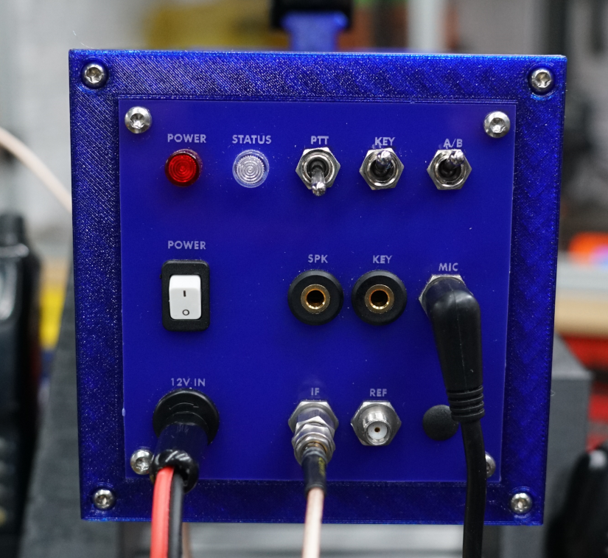
Front Panel Example
This front panel took ~20 minutes to design, 5 minutes to fabricate.
Labels are laser engraved, holes are laser cut, all in the same machine, in one job.
Sadly a decent consumer laser is ~$5,000+
You can order laser cut pieces online…

Slide 20
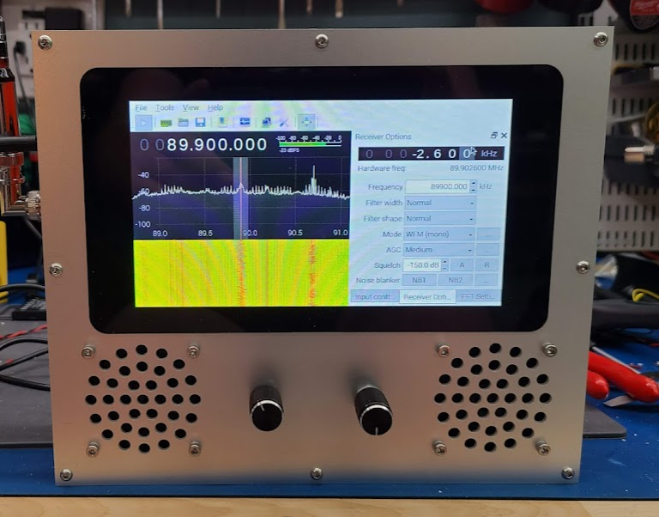
Metal panels
This panel is made from 6061 Aluminum
This front panel was cut on a waterjet.
Can also cut carbon fiber, or basically anything.
Cheapest machine is ~$25k
But you can get this service online too!

Slide 21
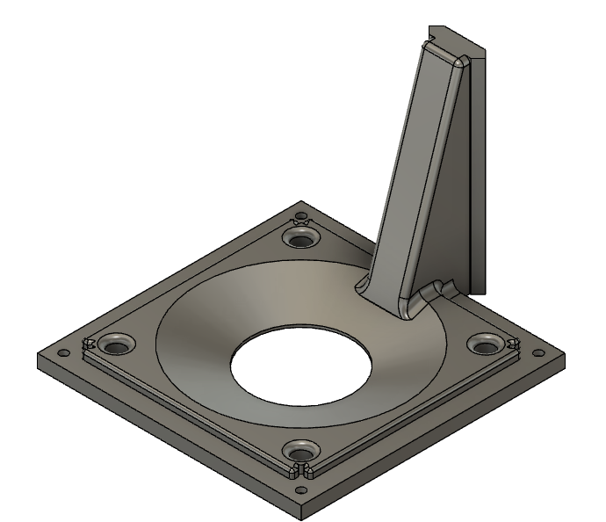
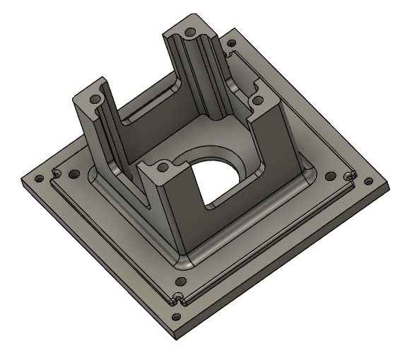
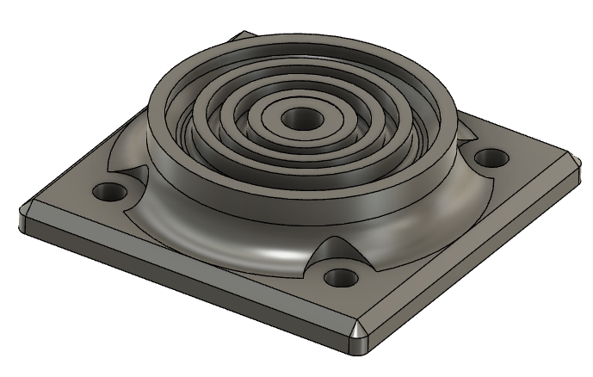
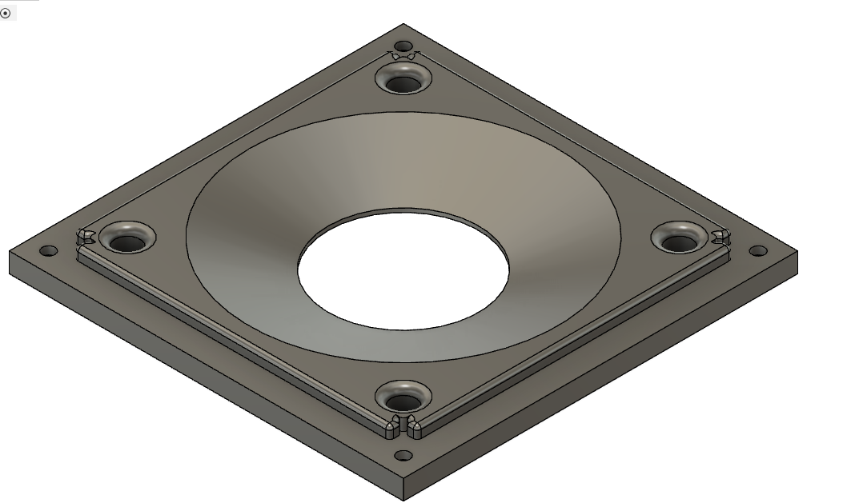
I use Fusion 360
Free for personal use
Some annoying limitations (cannot export 2D geometry unless you pay)
Has CAM

Slide 22
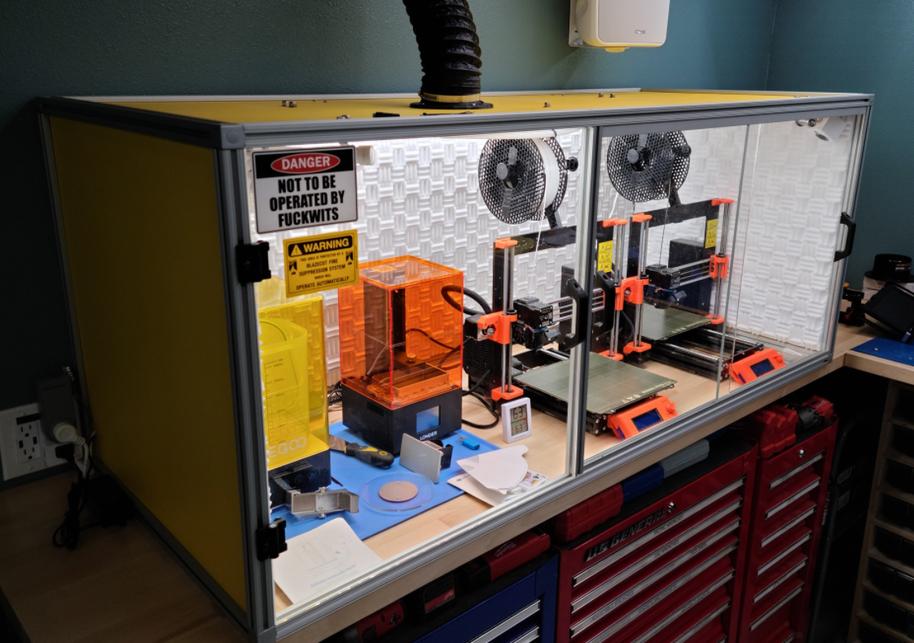
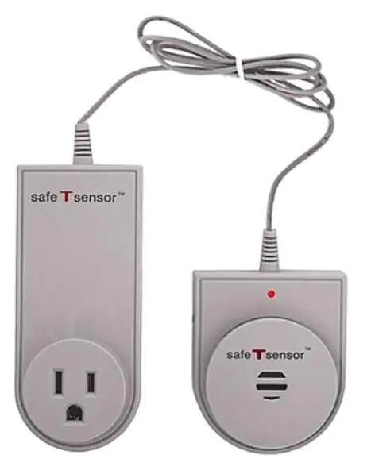

3D Printing at KC6QHP
2x Prusa i3 Mk3s+ FDM printers
1x Longer Orange 10 resin printer
Acoustically insulated, fire resistant enclosure with fume extraction and automatic fire suppression
Safe-T-Sensor: Cooking Fire Solution for Microwave Ovens
Blaze Cut automatic fire extinguisher

Slide 23
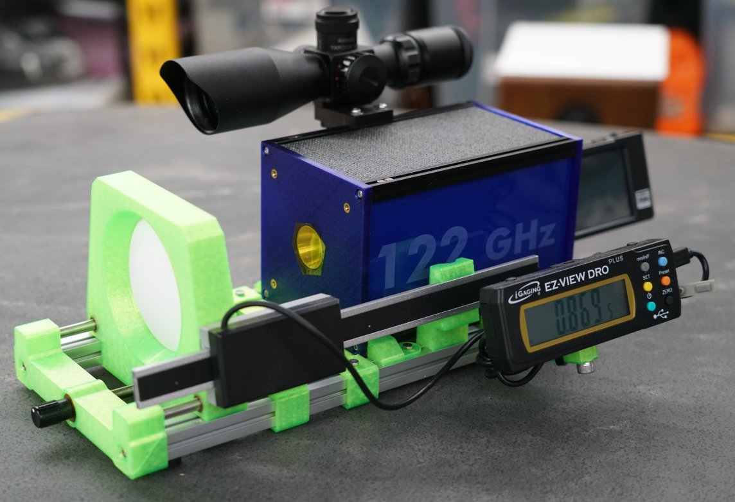
Antenna calibration fixture
Makerbeam aluminum extrusion used again, this time the XL size (15mmx15mm)
Threaded adjuster allows 1 inch of travel

Slide 24
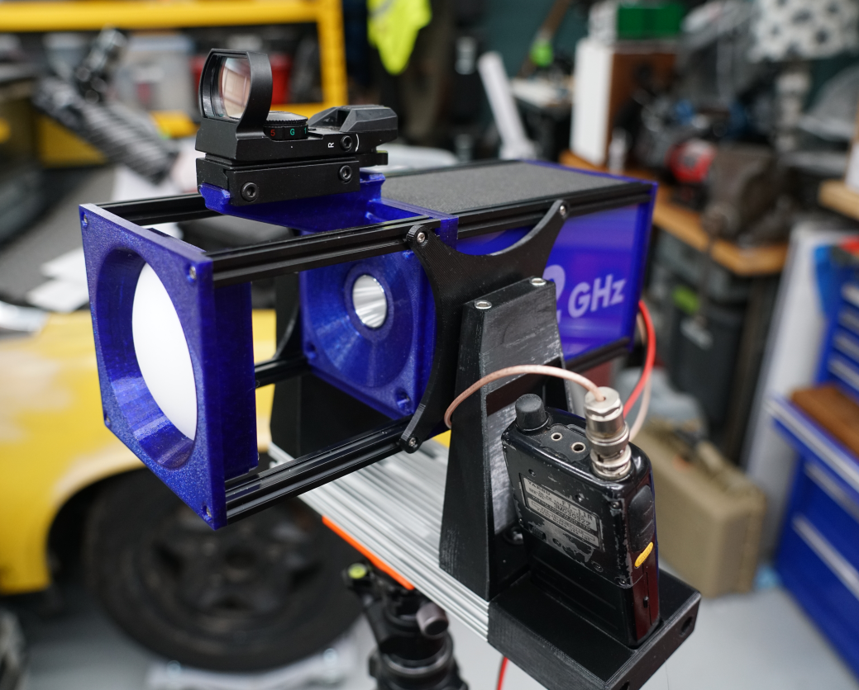
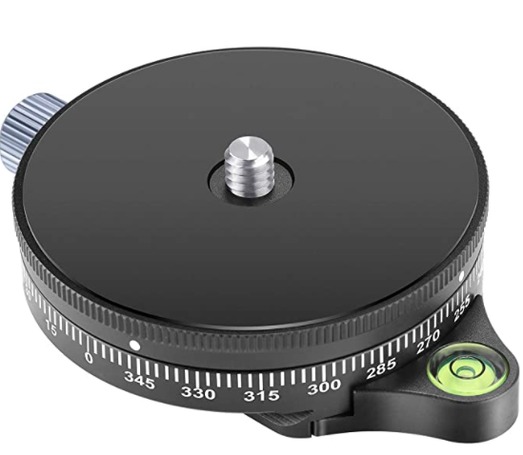
Completed Radio on 3D Printed Gimbal
Lens can be removed if desired.
Still finishing the worm gear drive for elevation adjustment
Azimuth adjustment is an inexpensive but very smooth pan head (and has printed graduations).

Slide 25
Demo Time
Show off the live demo from the back yard/ garage at KC6QHP QTH

